Slide 1
DAPO program application

Slide 2
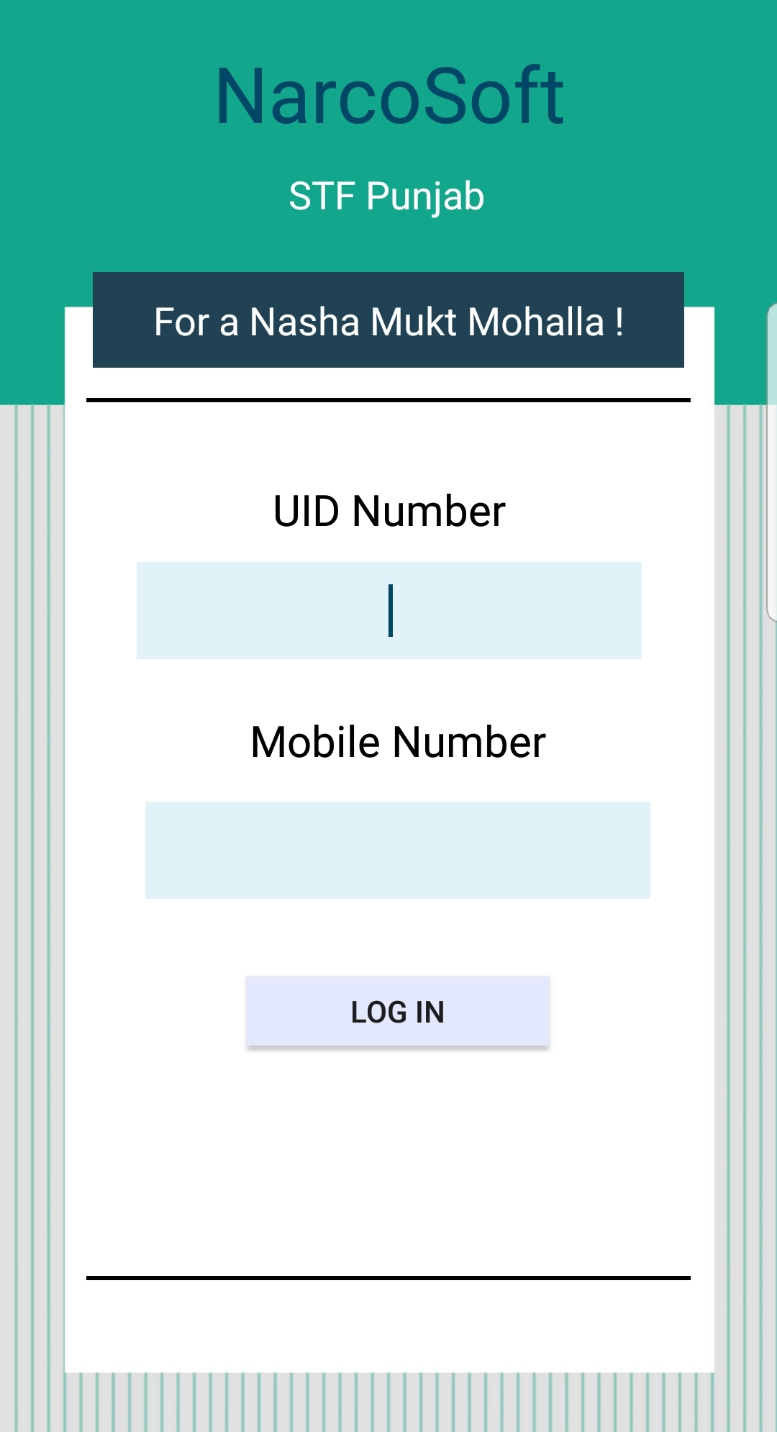
Login screen
LOGIN WILL BE DONE HERE
UNIQUE IDENTIFICATION NUMBER
MOBILE NUMBER

Slide 3
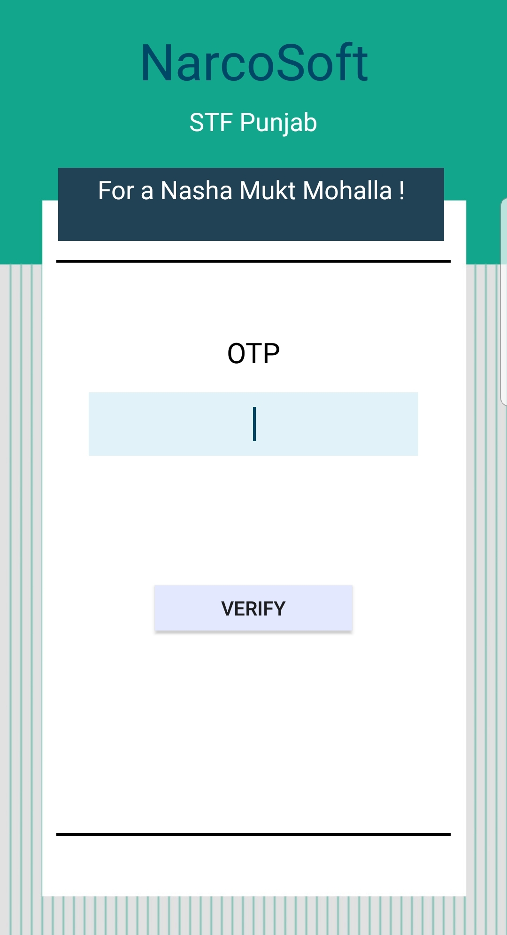
OTP verification
An OTP will be sent to the registered mobile number, which will be verified to give the user access to his/her dashboard

Slide 4
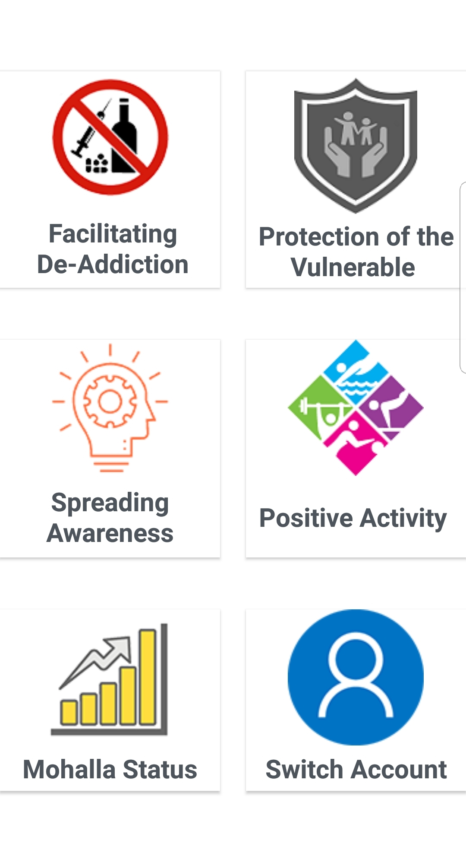
Main task page
Various subheadings available to choose for respective activity performed

Slide 5
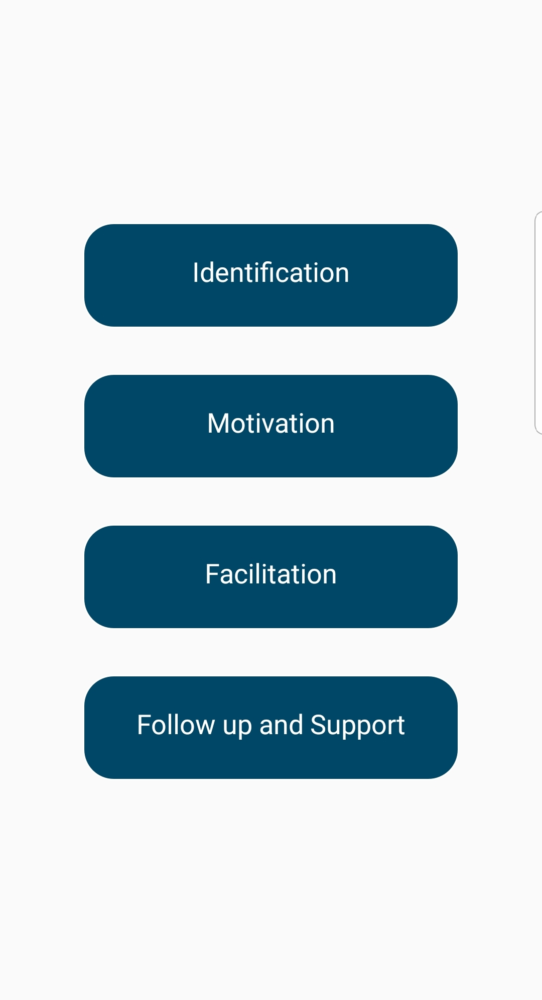
Facilitating DE-ADDICTION
ACTIVITIES UNDER DE-ADDICTION DIVIDED INTO 4 CATEGORIES

Slide 6
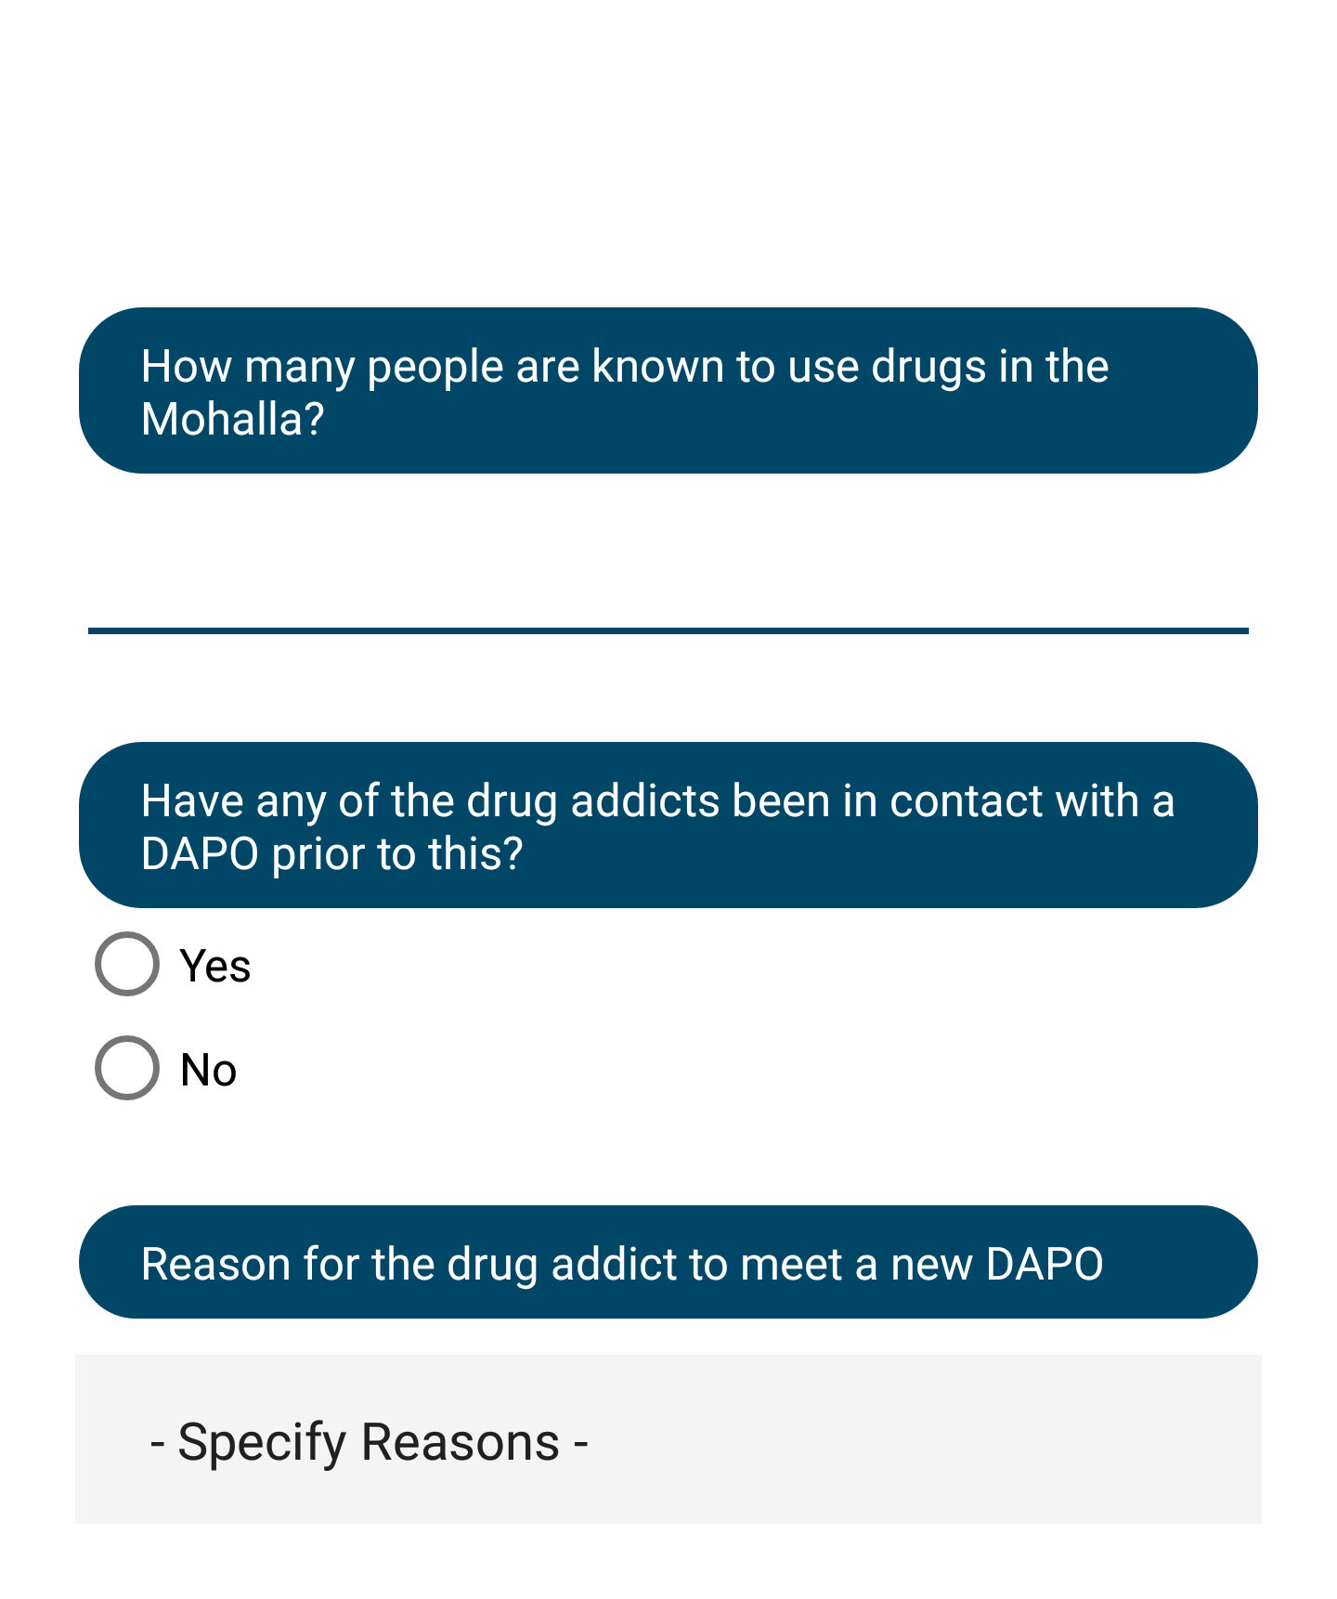
Facilitating DE-ADDICTION
IDENTIFICATION
Information gathered and efforts made regarding narcotics and users

Slide 7
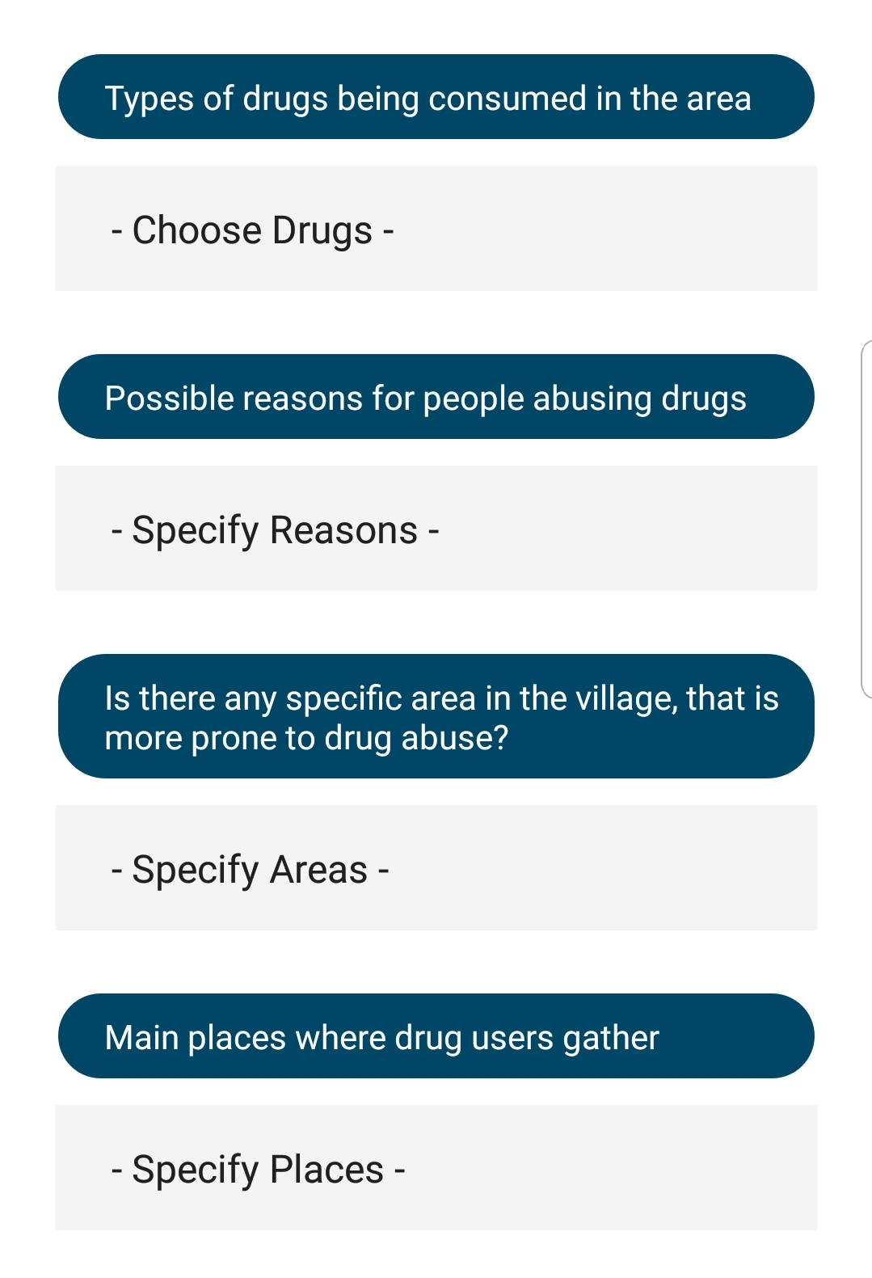
Facilitating DE-ADDICTION
IDENTIFICATION
Information gathered and efforts made regarding narcotics and users

Slide 8
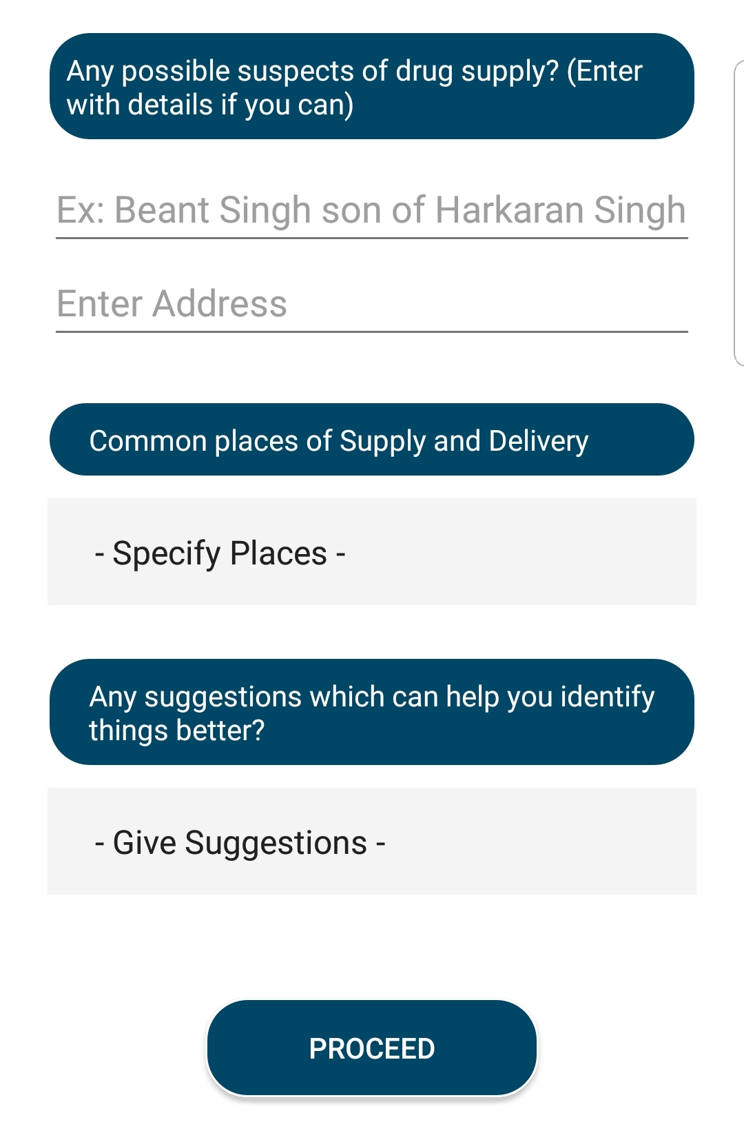
Facilitating DE-ADDICTION
IDENTIFICATION
Information gathered and efforts made regarding narcotics and users

Slide 9
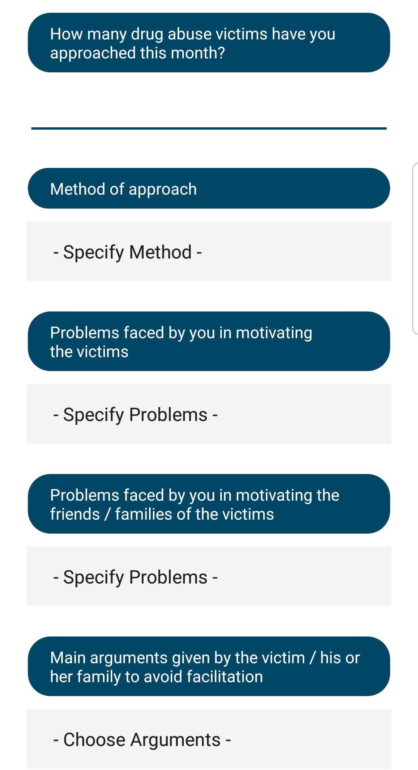
Facilitating DE-ADDICTION
MOTIVATION
Efforts made to make drug users aware of the ill effects of drug abuse and to persuade them to get appropriate treatment for rehabilitation

Slide 10
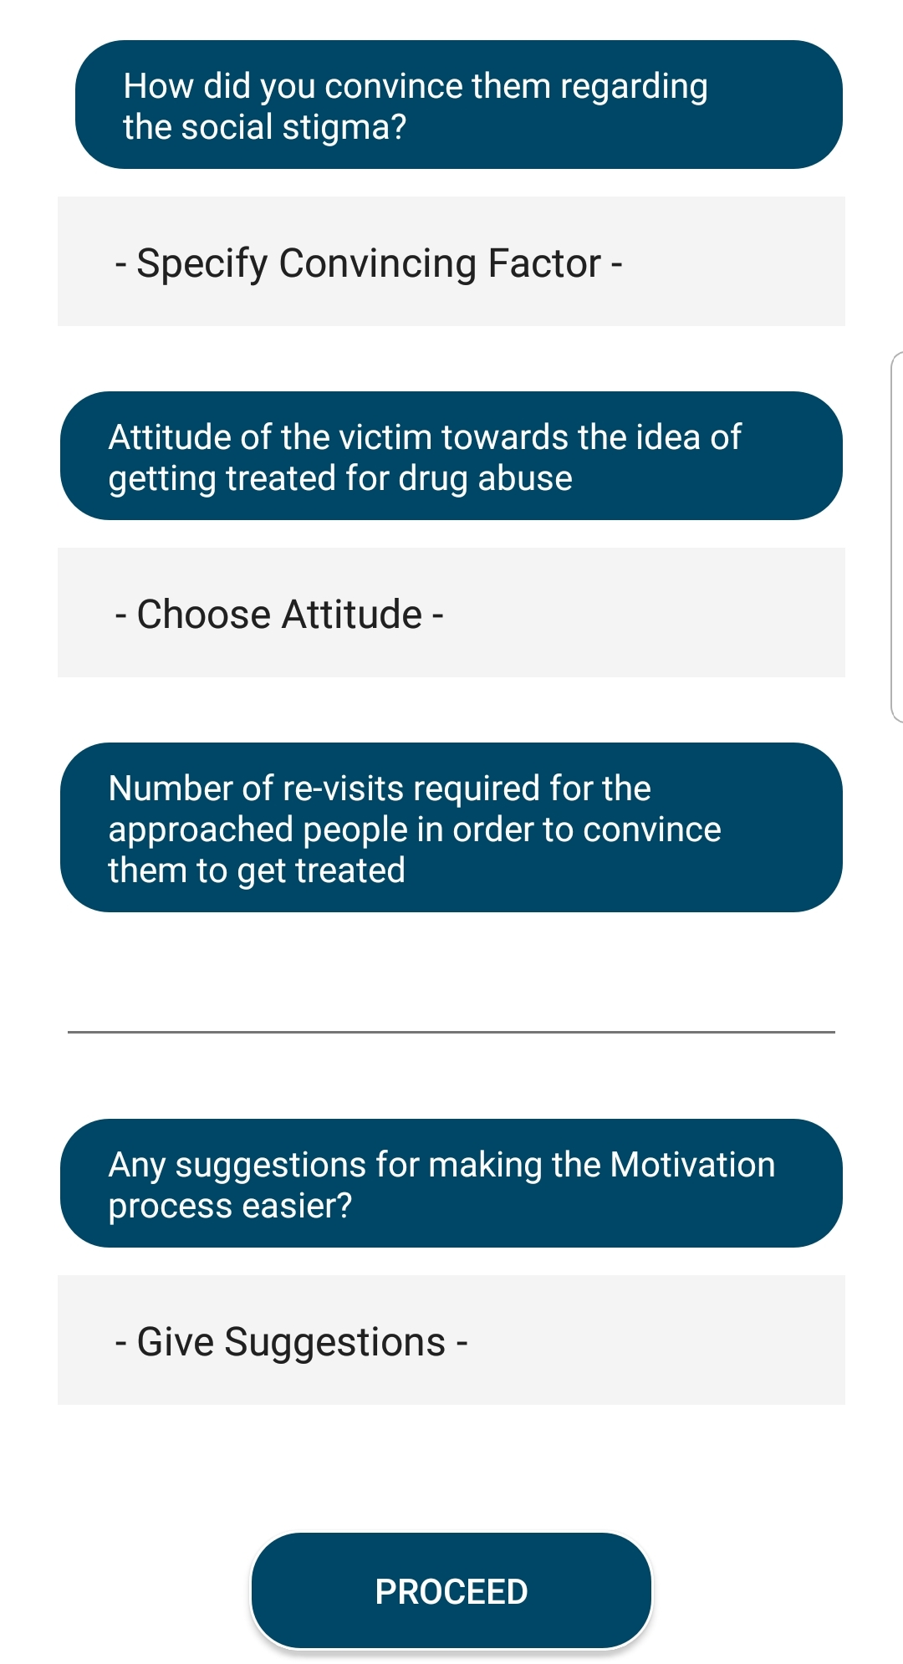
Facilitating DE-ADDICTION
MOTIVATION
Efforts made to make drug users aware of the ill effects of drug abuse and to persuade them to get appropriate treatment for rehabilitation

Slide 11
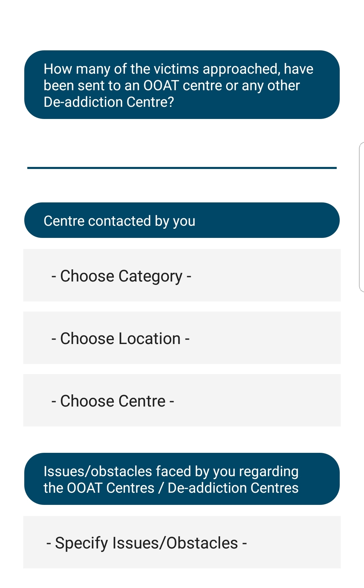
Facilitating DE-ADDICTION
FACILITATION
Linking the drug abuse victims to
OAAT/De-Addiction Centres
Rehabilitation Details

Slide 12
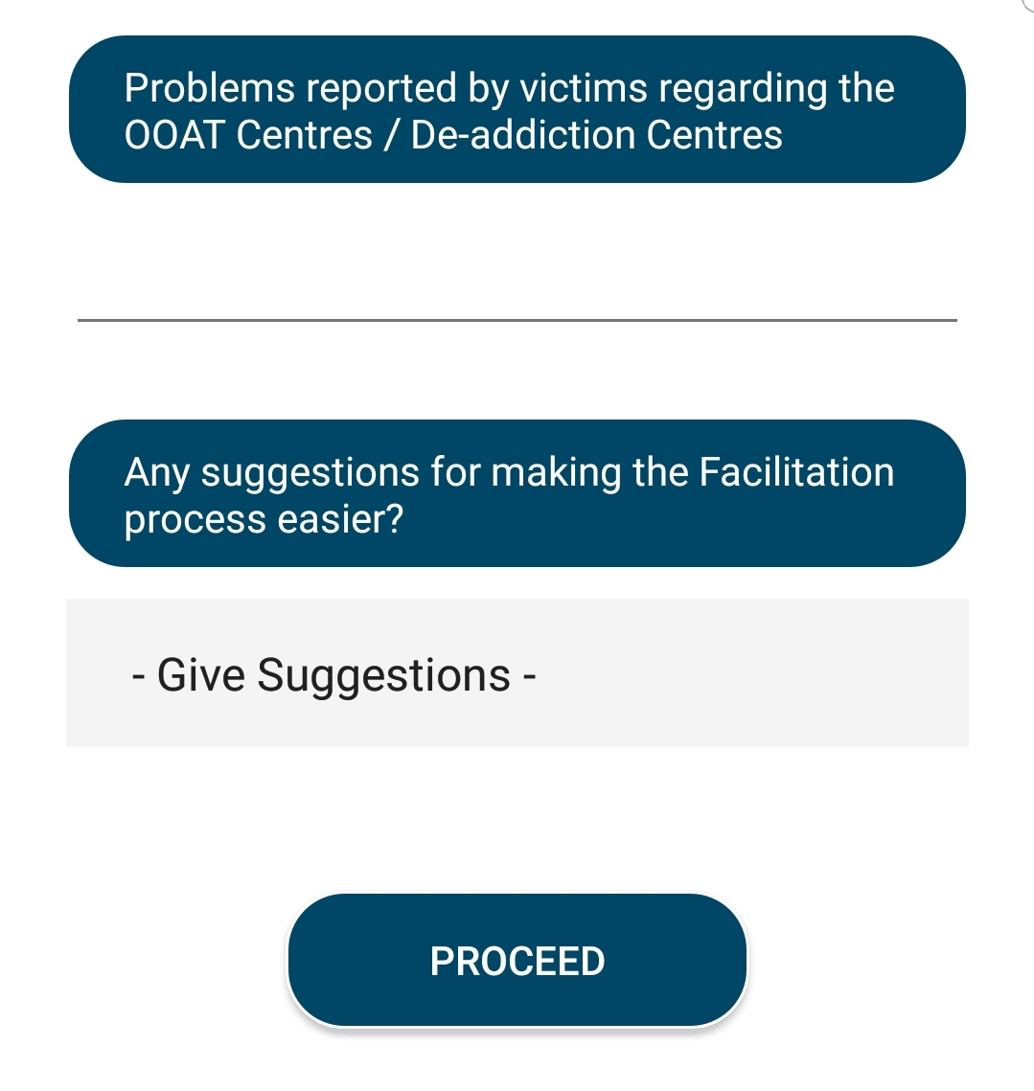
Facilitating DE-ADDICTION
FACILITATION
Linking the drug abuse victims to
OAAT/De-Addiction Centres
Rehabilitation Details

Slide 13
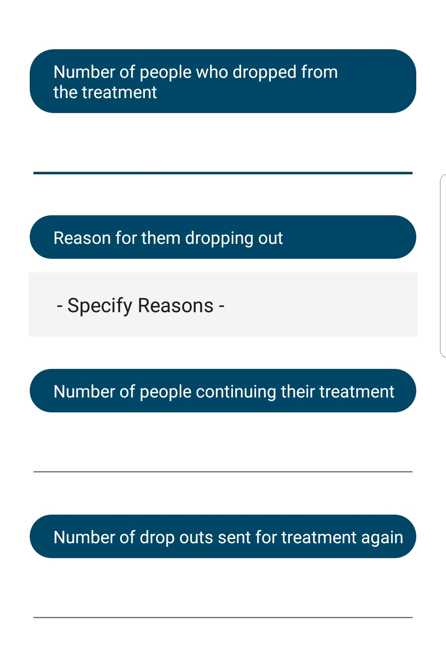
Facilitating DE-ADDICTION
FOLLOW UP & SUPPORT
Follow ups on the treatment of the drug addicts

Slide 14
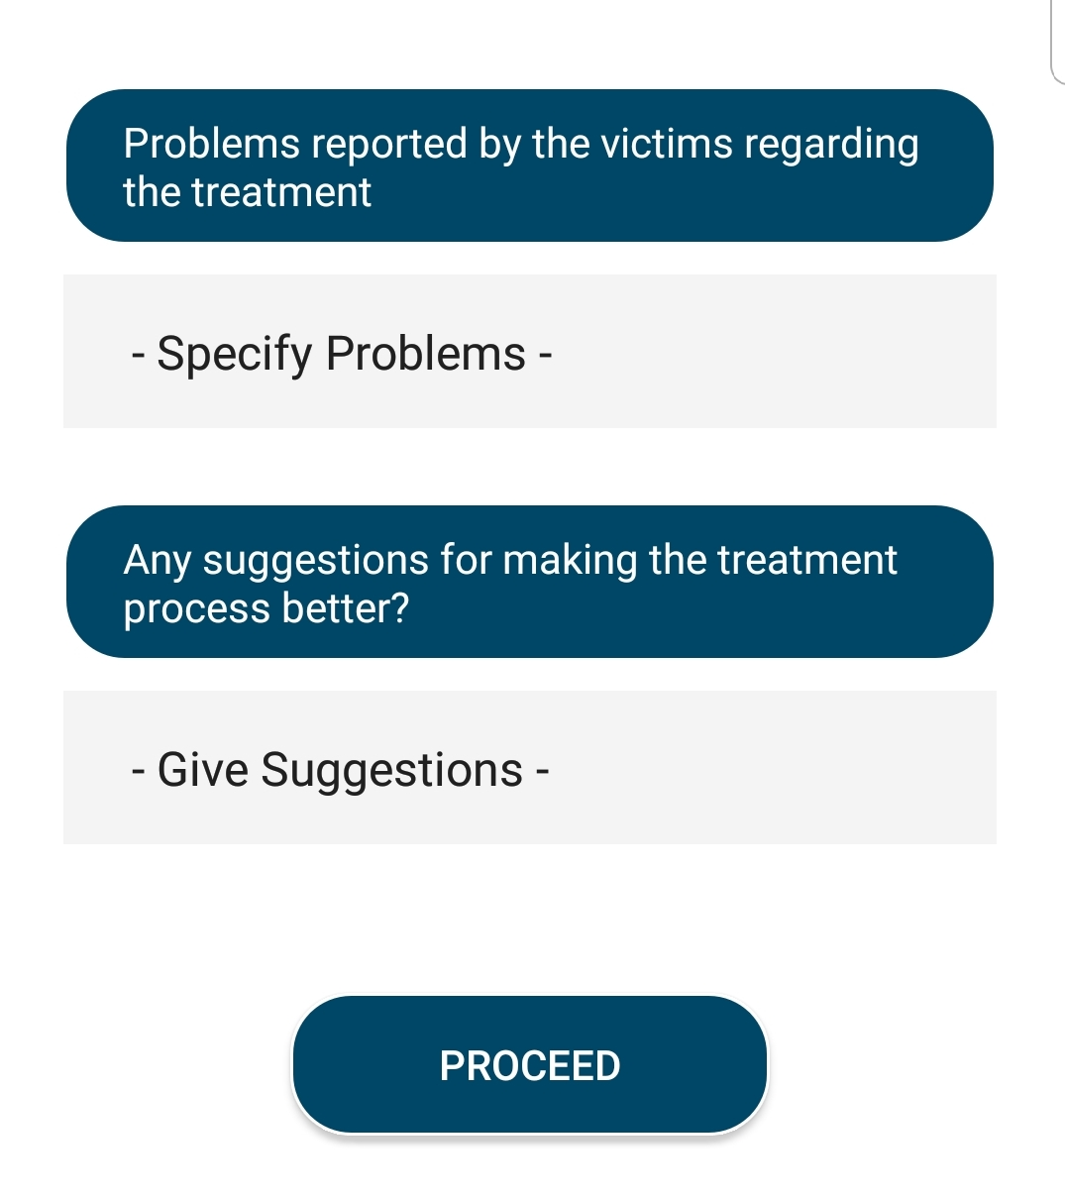
Facilitating DE-ADDICTION
FOLLOW UP & SUPPORT
Follow ups on the treatment of the drug addicts

Slide 15
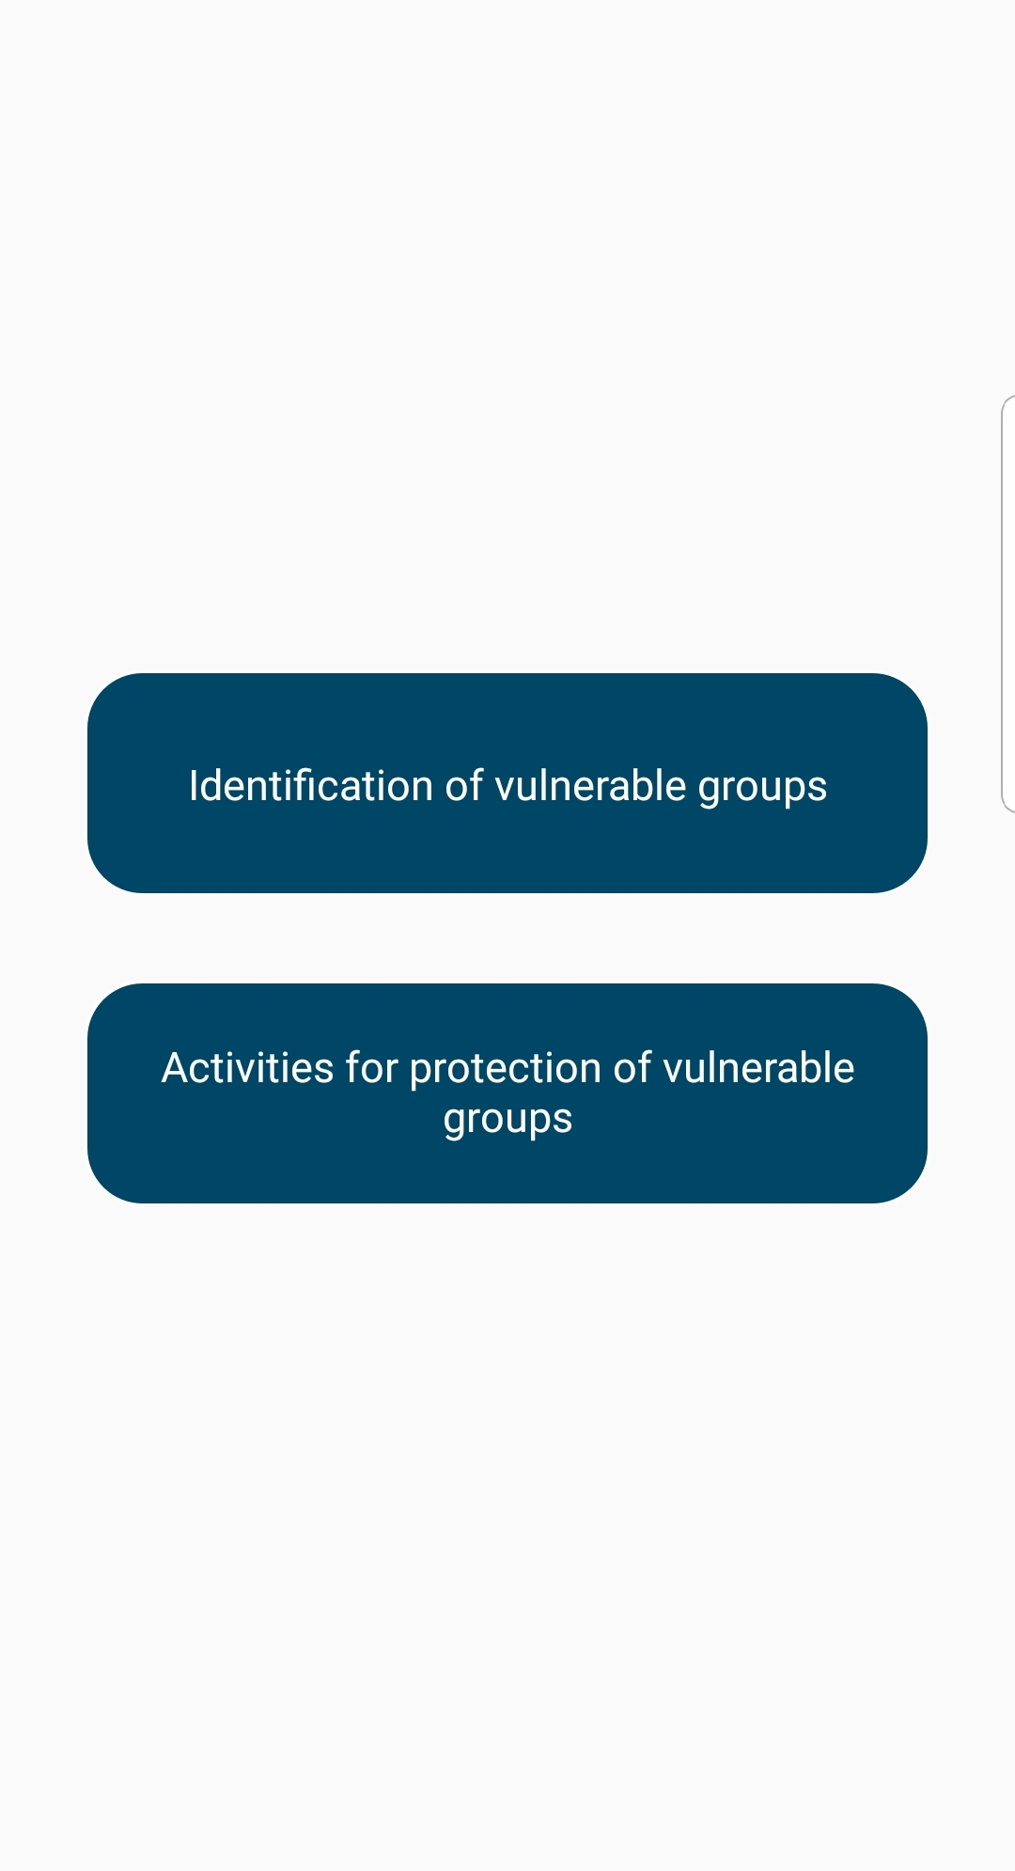
PROTECTION of the vulnerable
Identification of the Vulnerable
Protection of the Vulnerable

Slide 16
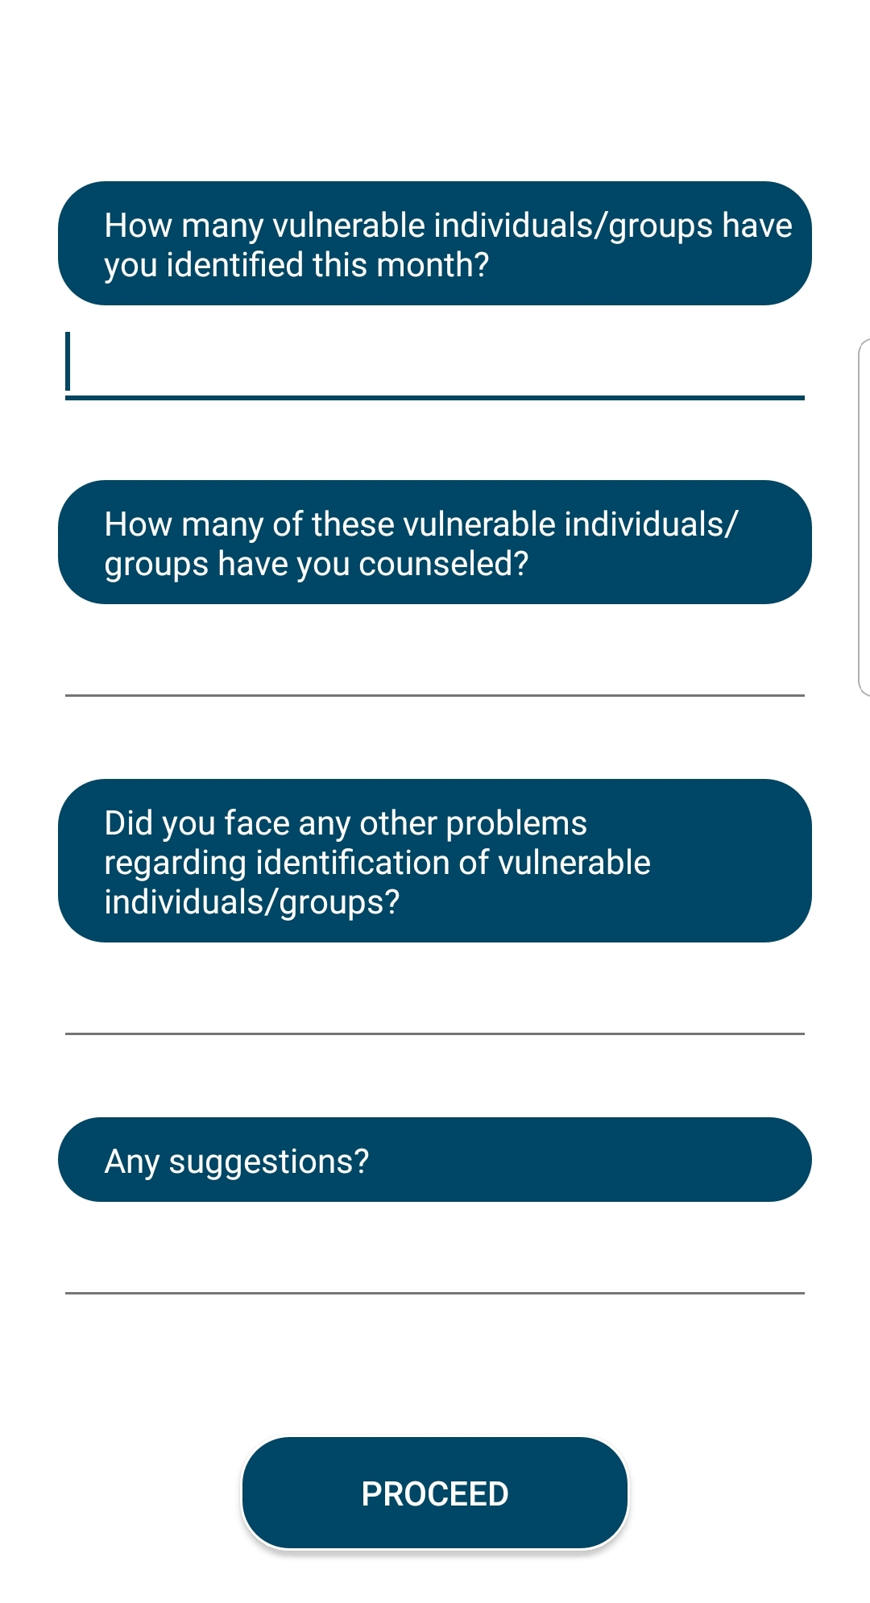
PROTECTION of the vulnerable
Identifying potential drug users and vulnerable groups like the social circle of drug abuse victims

Slide 17
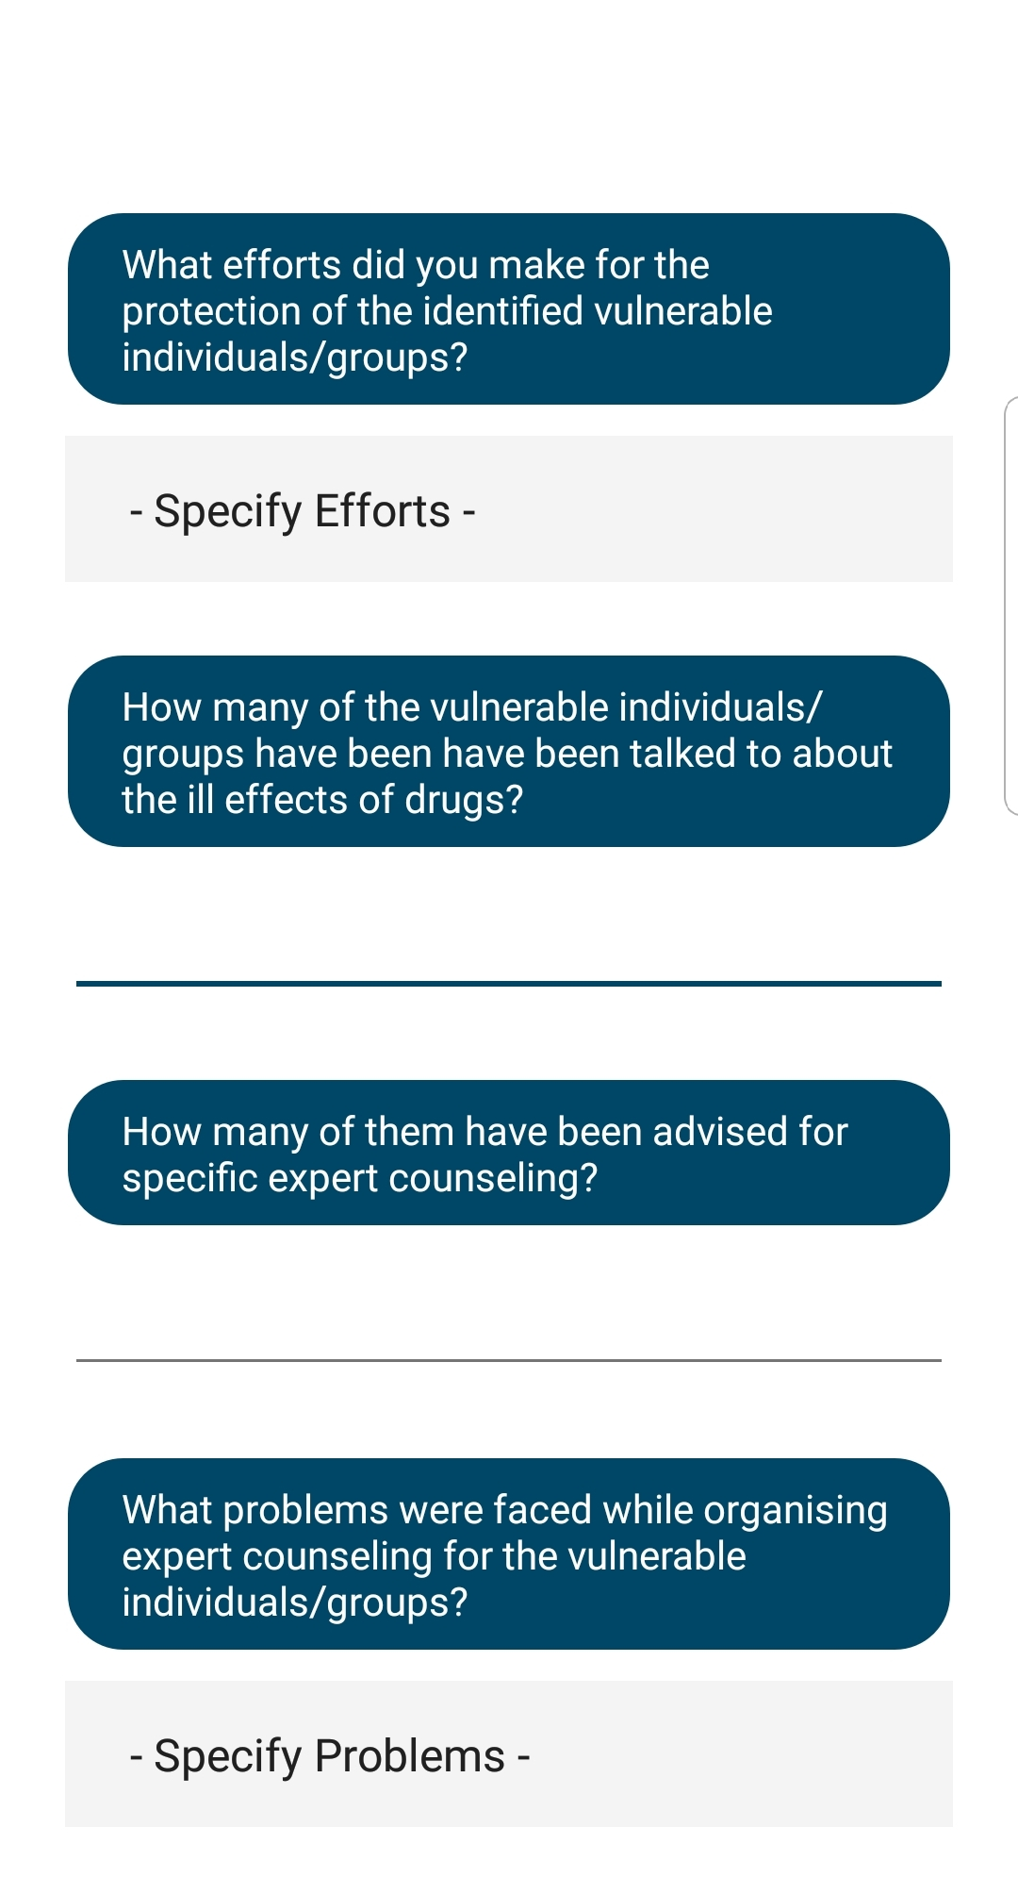
PROTECTION of the vulnerable
Efforts made to keep said vulnerable away from drugs

Slide 18
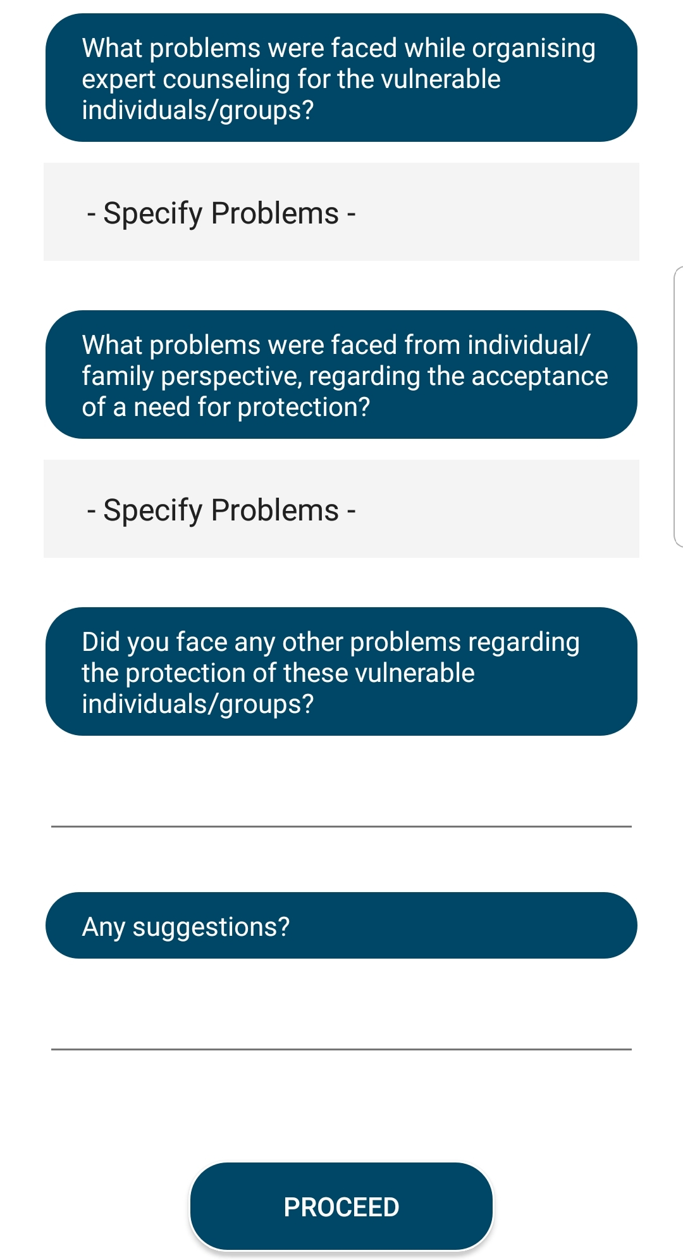
PROTECTION of the vulnerable
Efforts made to keep said vulnerable away from drugs

Slide 19
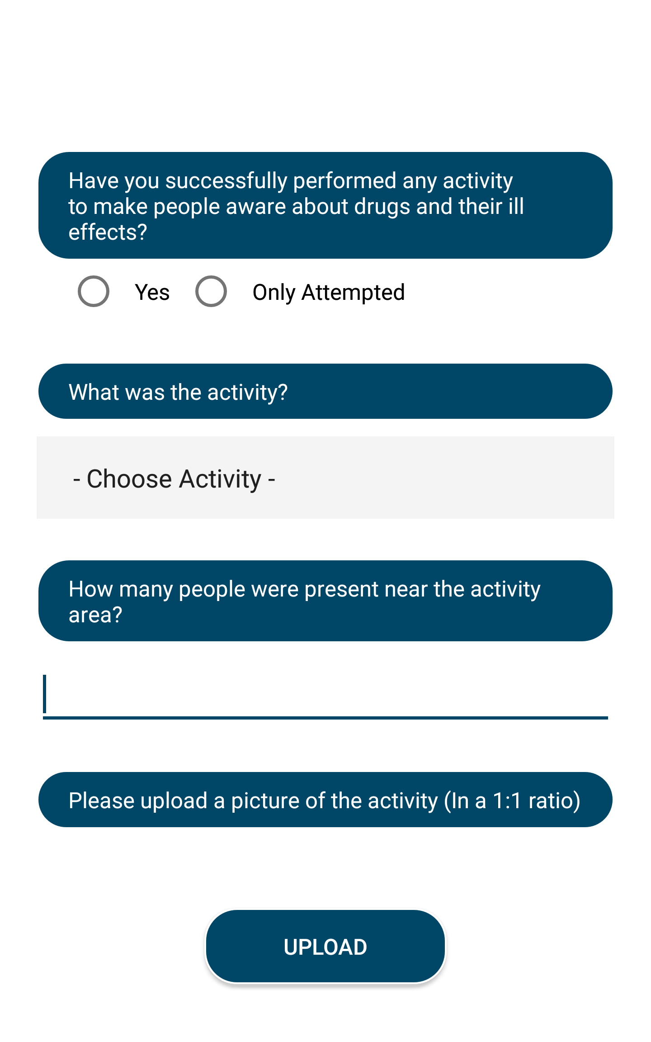
Spreading AWARENESS
Efforts made to make people aware of the ill effects of narcotics

Slide 20
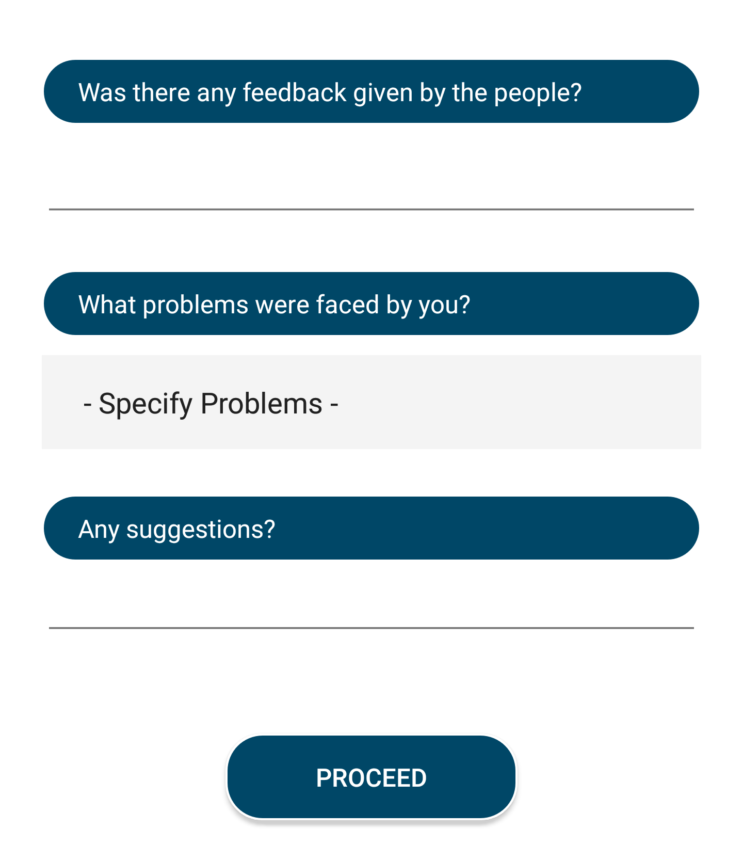
Spreading AWARENESS
Efforts made to make people aware of the ill effects of narcotics

Slide 21
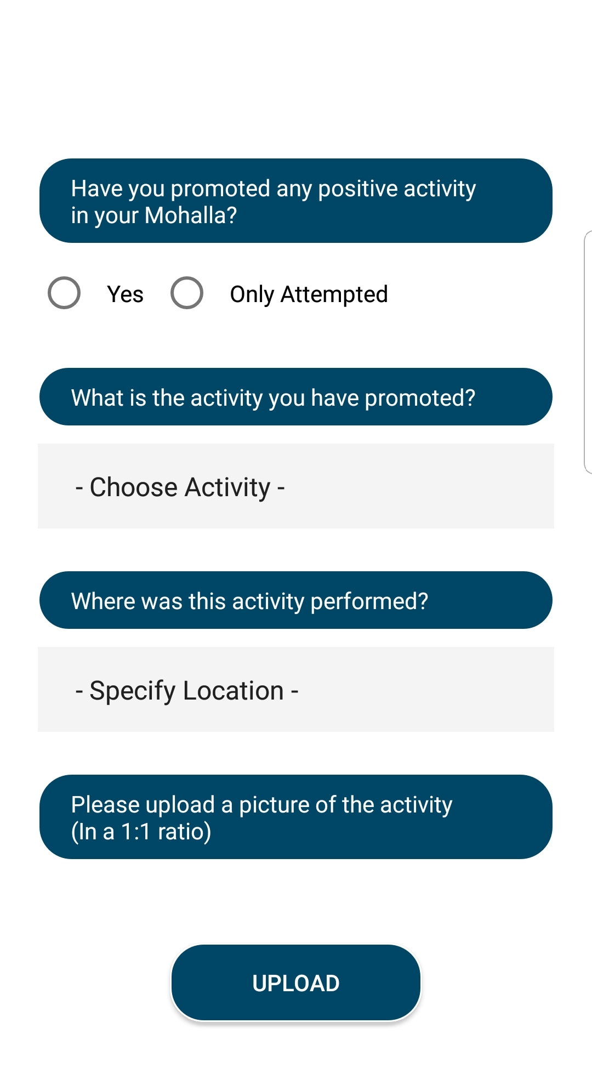
Positive activities
Efforts made to promote people’s involvement in positive activities and to keep them busy thus promoting a healthy lifestyle

Slide 22
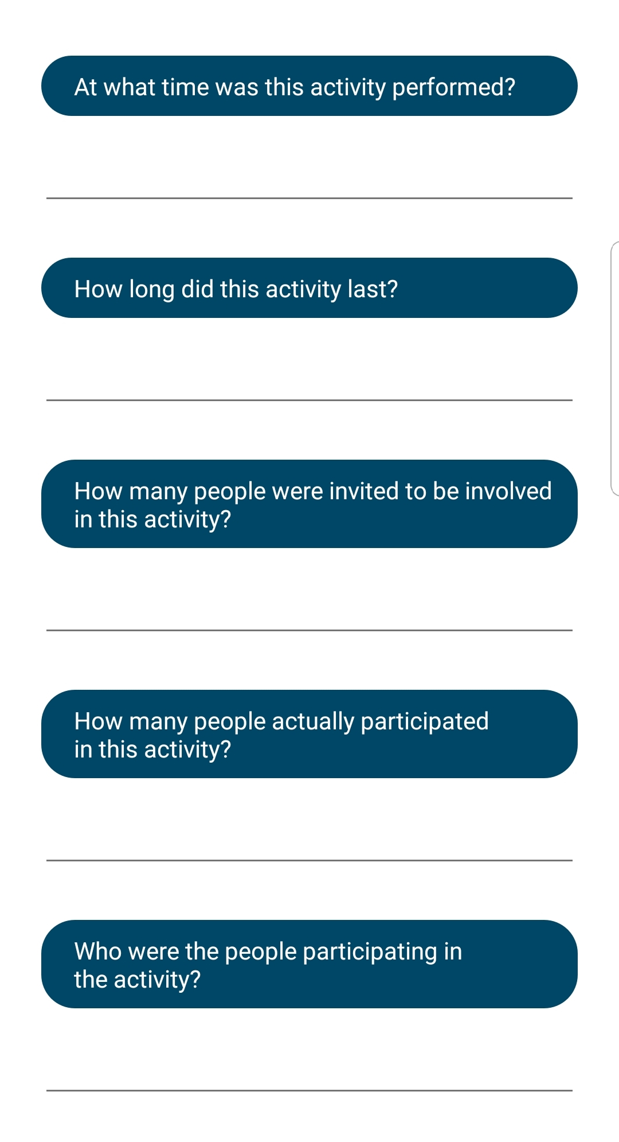
Positive activities
Efforts made to promote people’s involvement in positive activities and to keep them busy thus promoting a healthy lifestyle

Slide 23
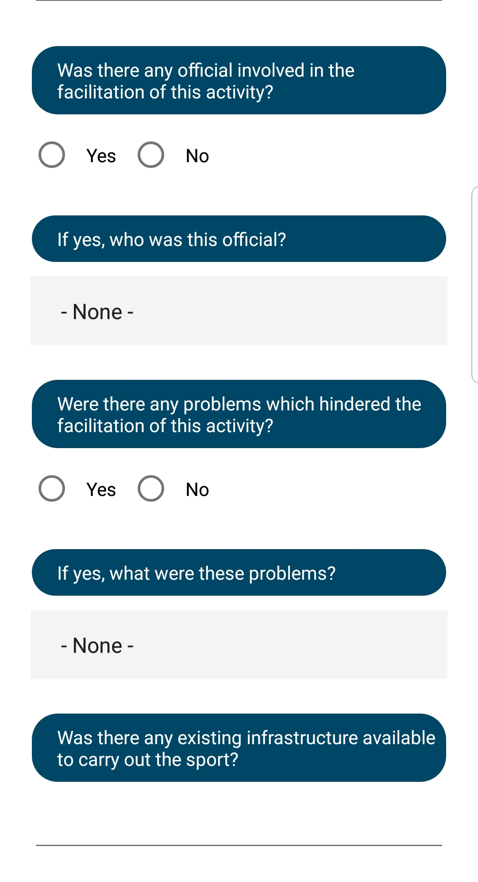
Positive activities
Efforts made to promote people’s involvement in positive activities and to keep them busy thus promoting a healthy lifestyle

Slide 24
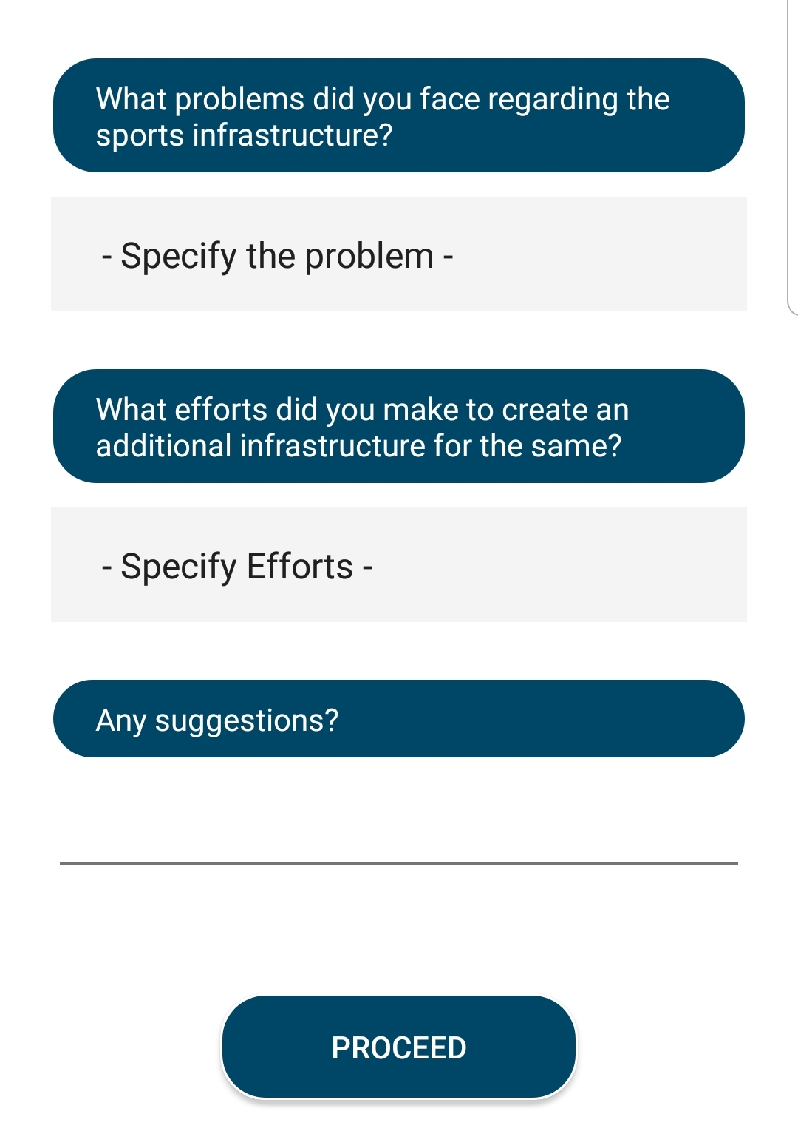
Positive activities
Efforts made to promote people’s involvement in positive activities and to keep them busy thus promoting a healthy lifestyle

Slide 25
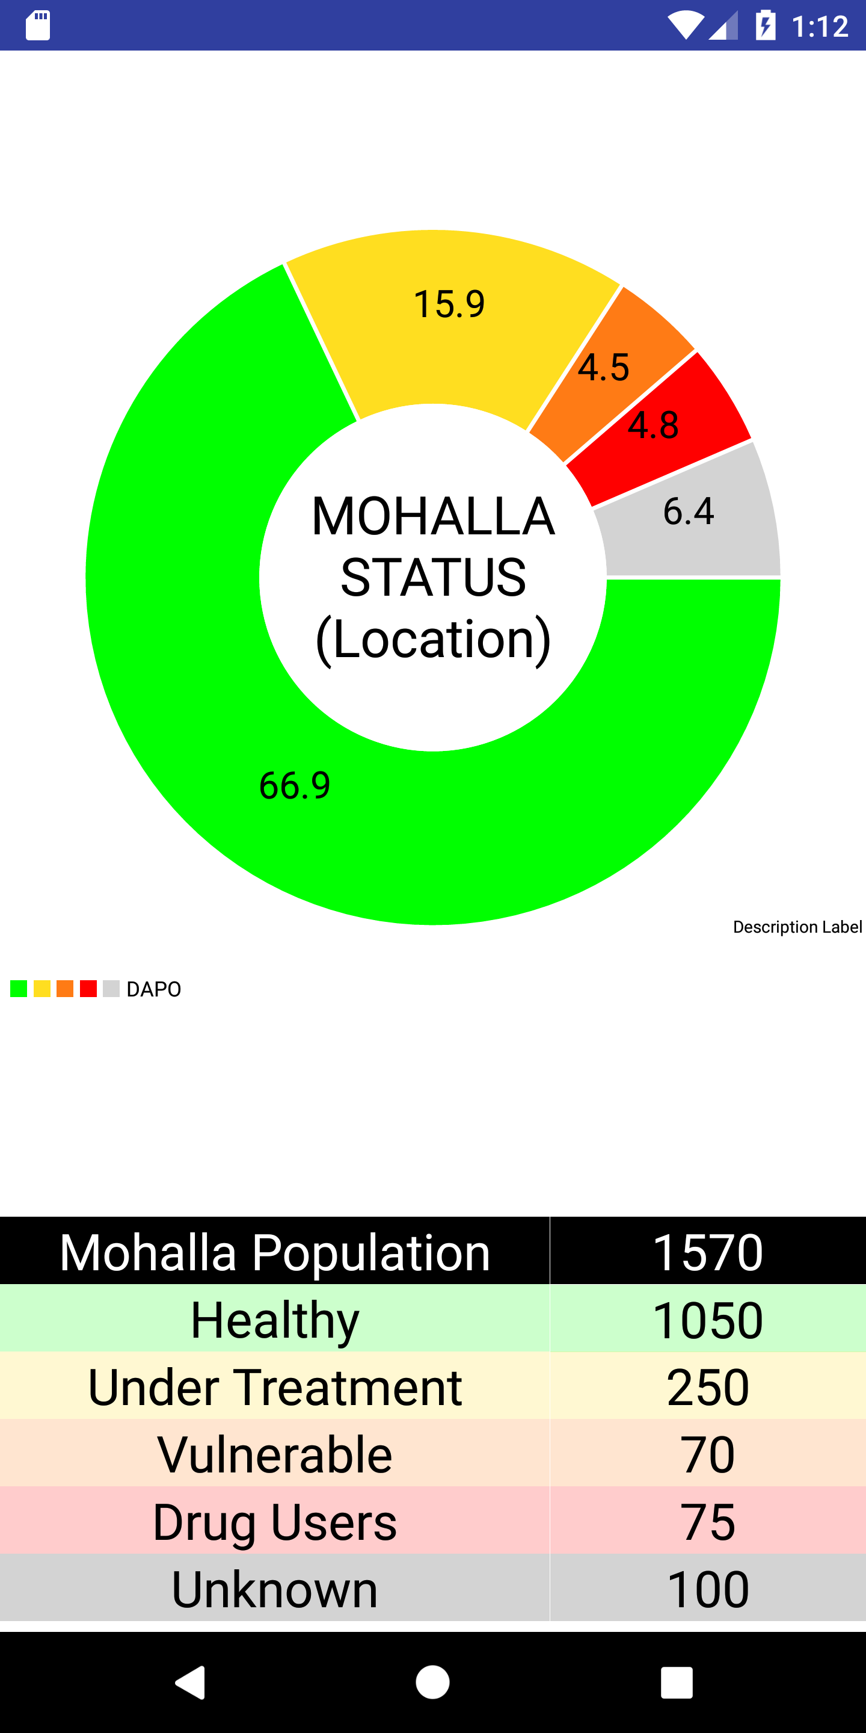
Mohalla status
Pie chart representation of the mohalla’s population status

Slide 26
APPS FOR HIGHER LEVELS
One app for NRNC ,CC , SDMT , DMT levels & a standalone app for STF level

Slide 27
Prime application
One combined app for NRNC ,CC , SDMT , DMT levels, with a log in based role allocation system

Slide 28
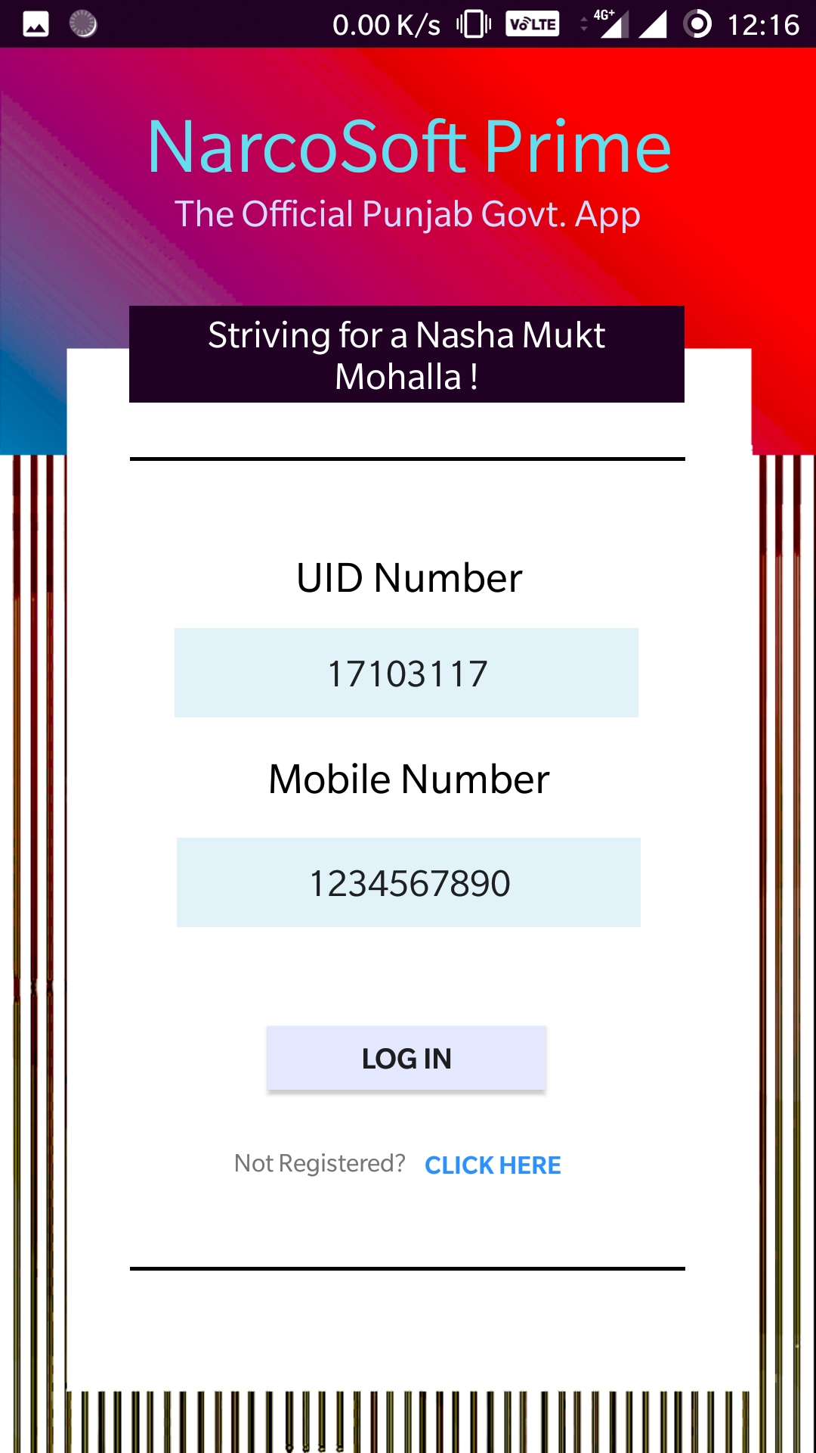
Login screen
Log in using UID Number and Mobile Number associated with the registration
If a user is has not registered yet, they can do so directly from the app itself, where their role will be recognised

Slide 29
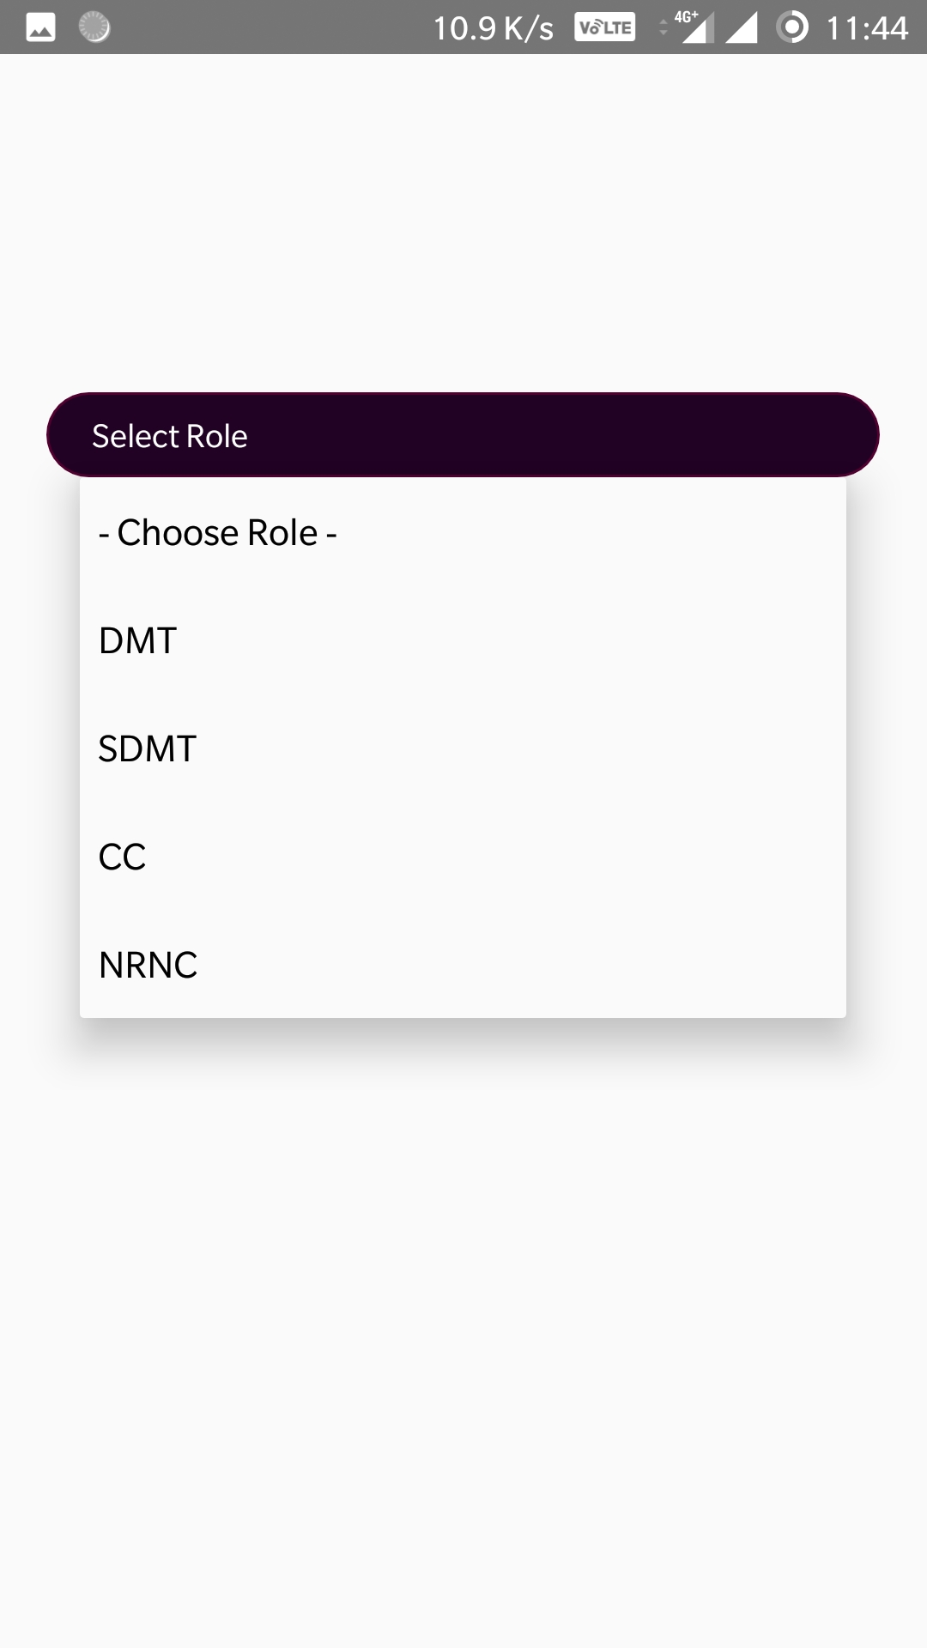
Role choosing screen
Once a role has been chosen,
(Eg: DMT, SDMT, etc), the registration screen will open, where the necessary details will be asked from the user

Slide 30
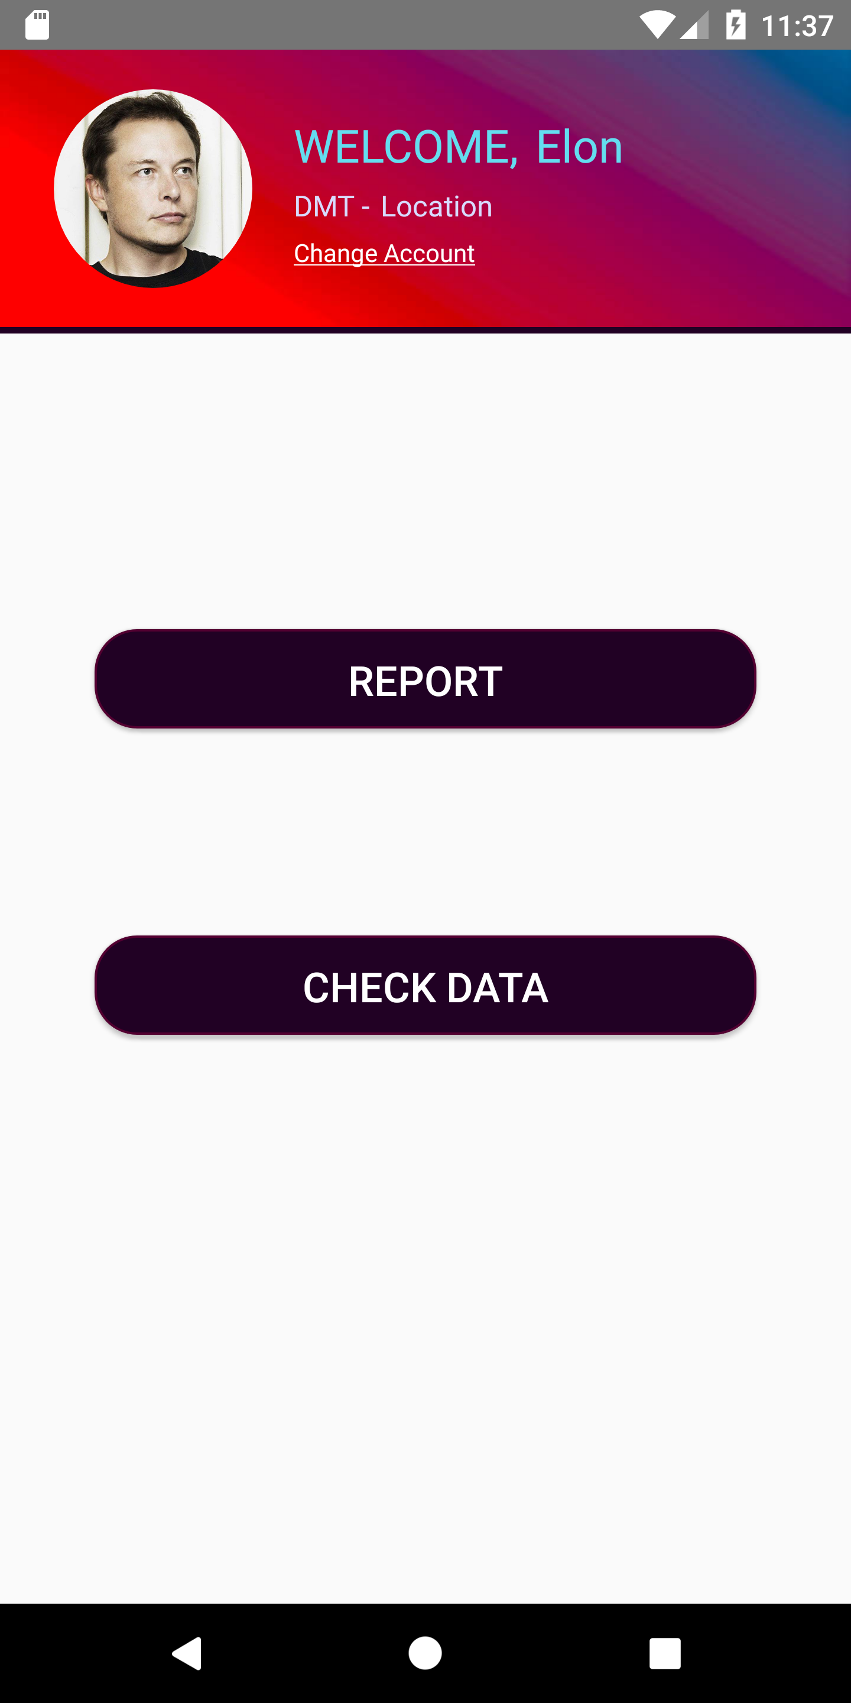
Home screen
2 Buttons:
1) Reporting to higher level
2) Checking the data for lower levels

Slide 31
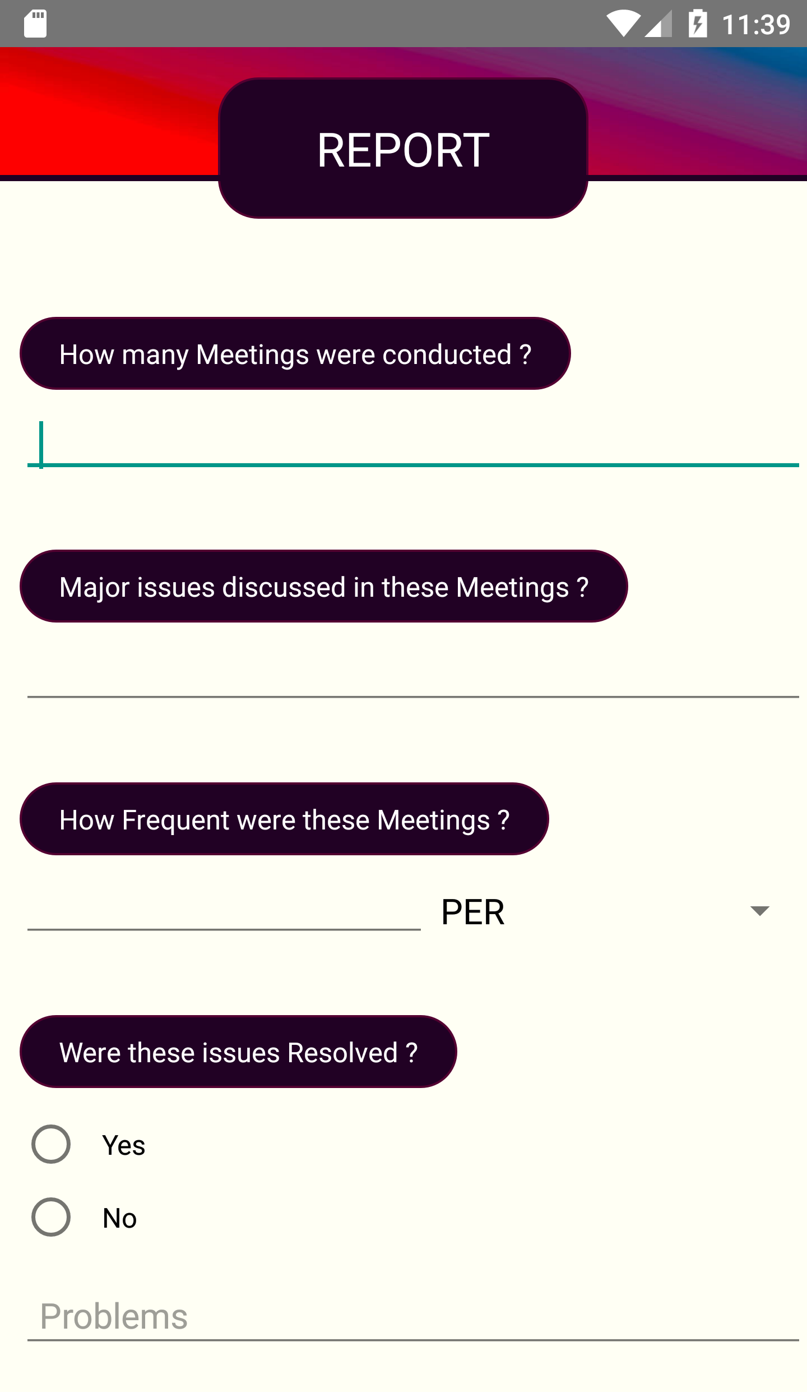
REPORT PAGE
Form which will be sent to higher levels for data analysis and evaluation

Slide 32
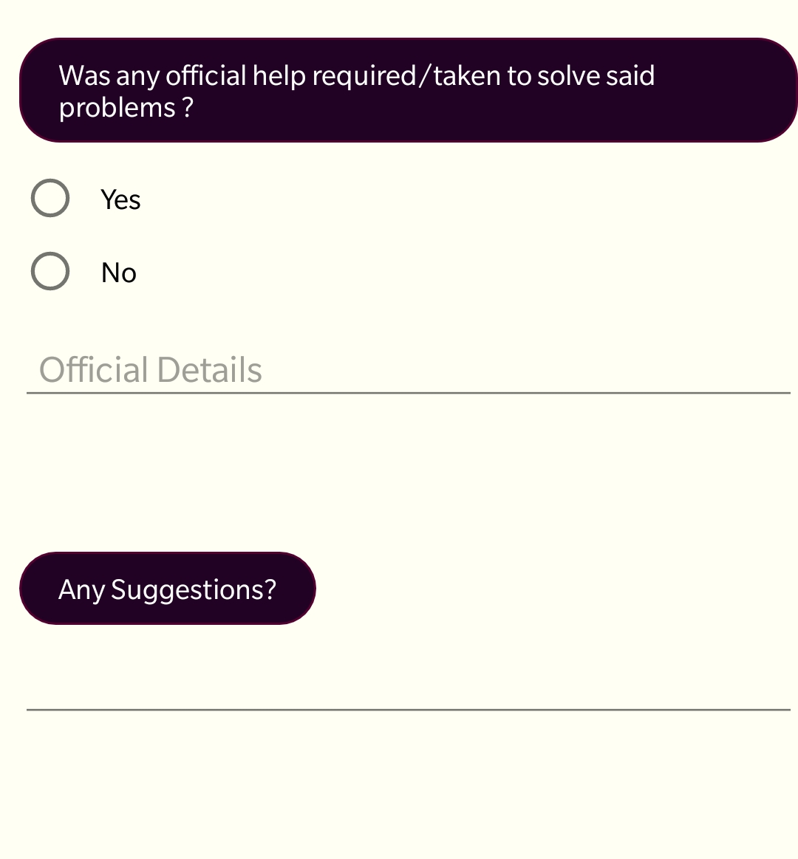
REPORT PAGE
Form which will be sent to higher levels for data analysis and evaluation

Slide 33
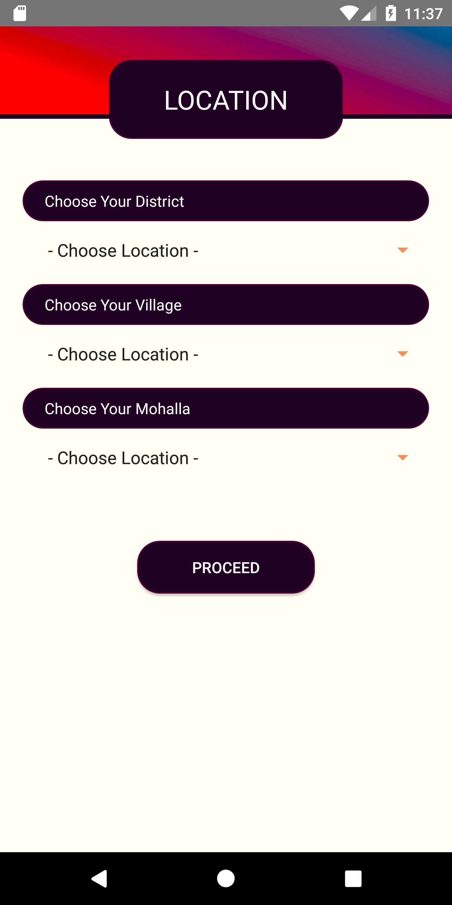
Location filter
Sorting the corresponding lower levels according to their registered location

Slide 34
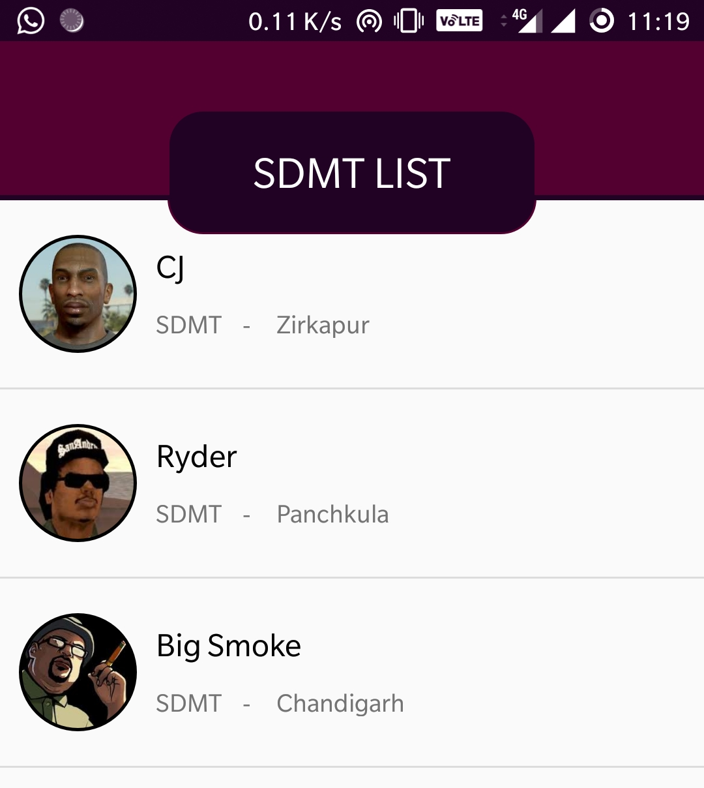
List of Lower level members
On click for each member will show a brief description of their activities

Slide 35
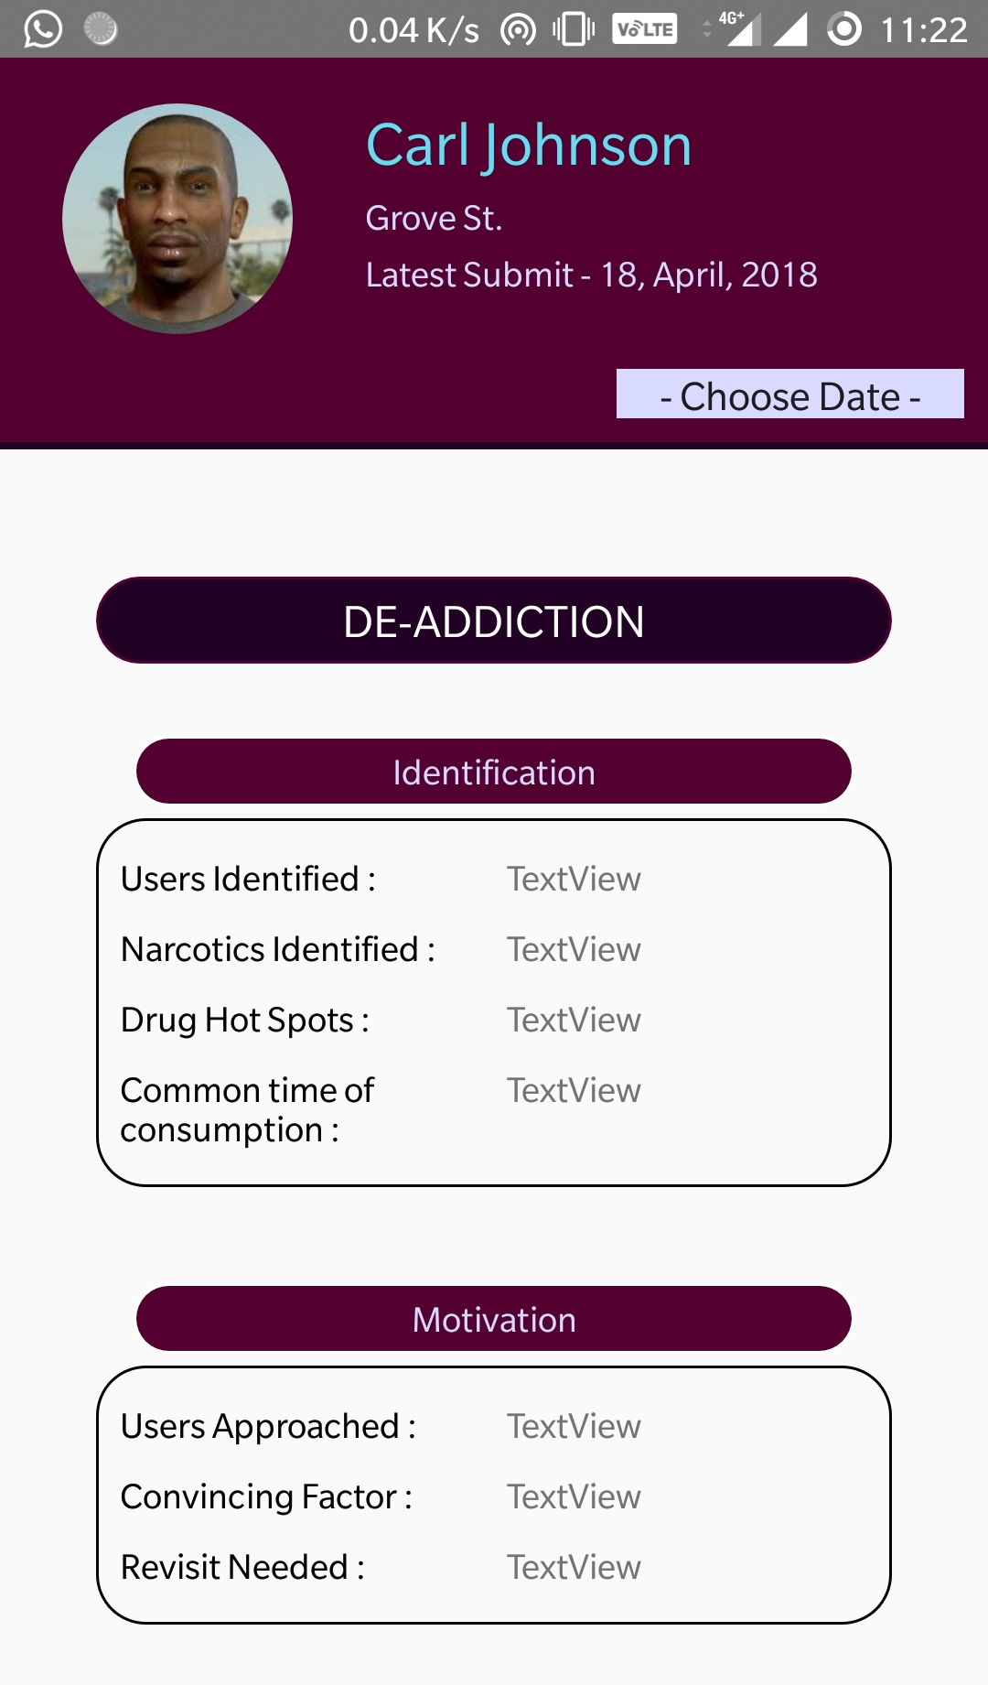
Brief Description
List provides brief description of all the work done by the DAPO

Slide 36
Special task force (stf) application
Corresponding application for use by STF

Slide 37
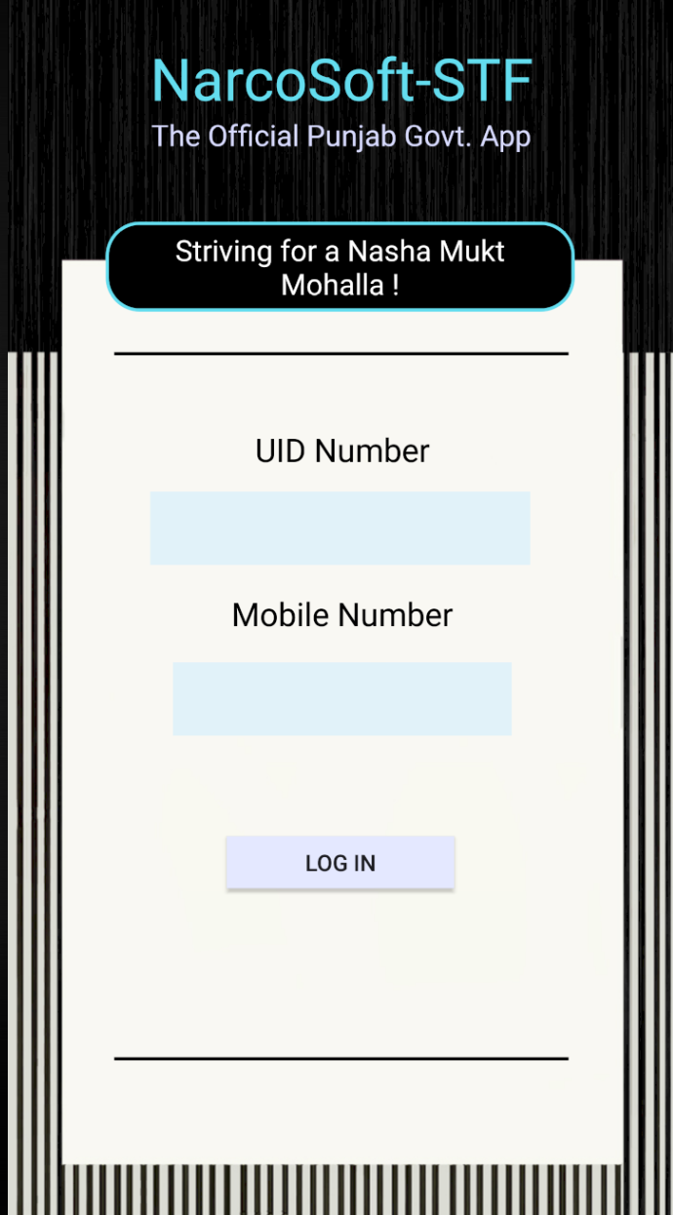
STF
Login Page

Slide 38
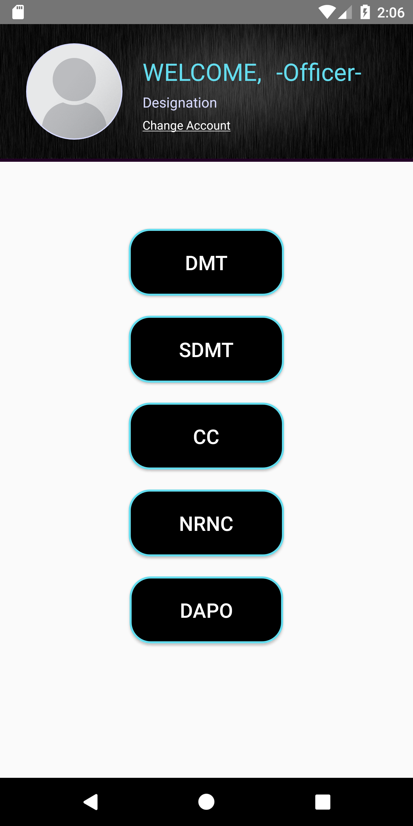
HOME PAGE
List of buttons to check the corresponding levels of hierarchy and their data

Slide 39
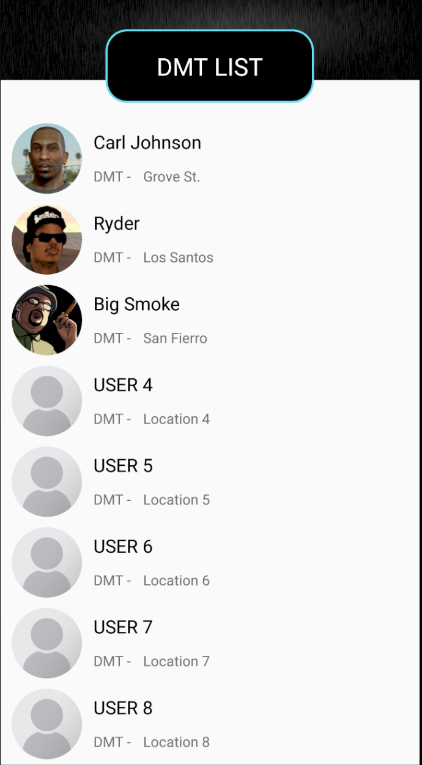
List of people under the hierarchical level
Corresponding list items can be clicked for respective info

Slide 40
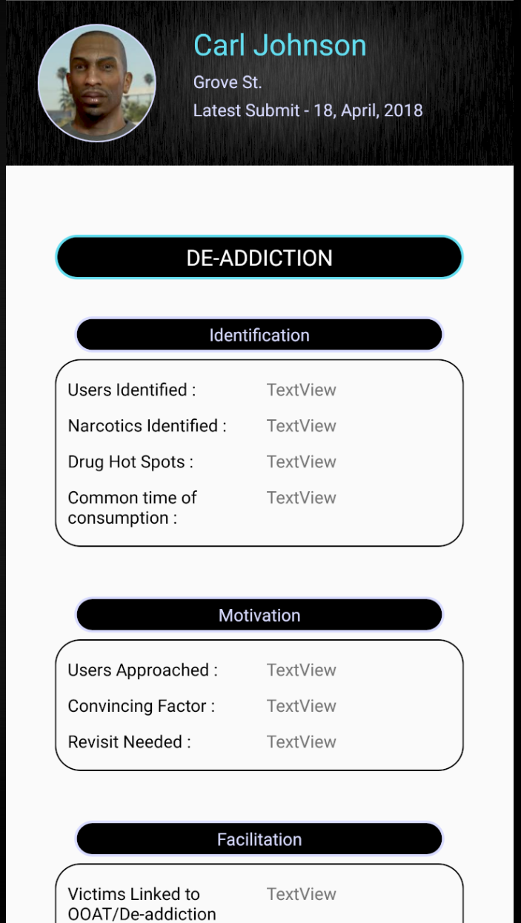
BRIEF PROGRESS
Shortened version of DAPO’s activities

Slide 41
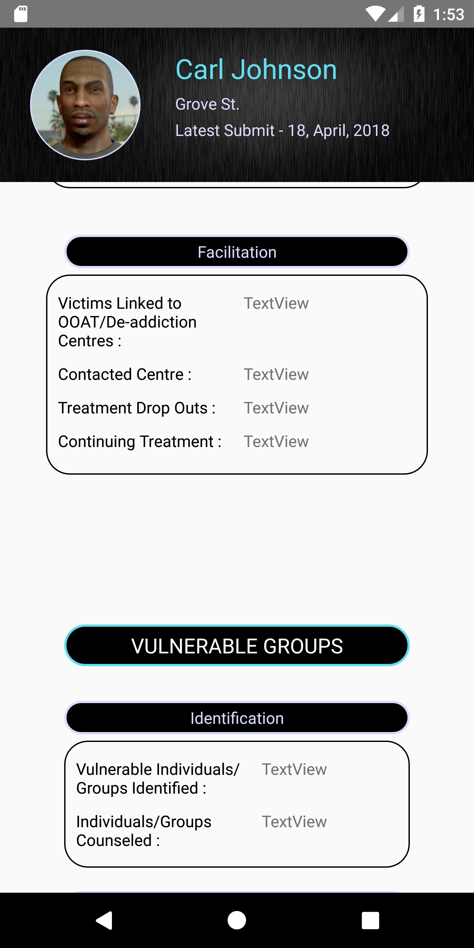
BRIEF PROGRESS
Shortened version of DAPO’s activities

Slide 42
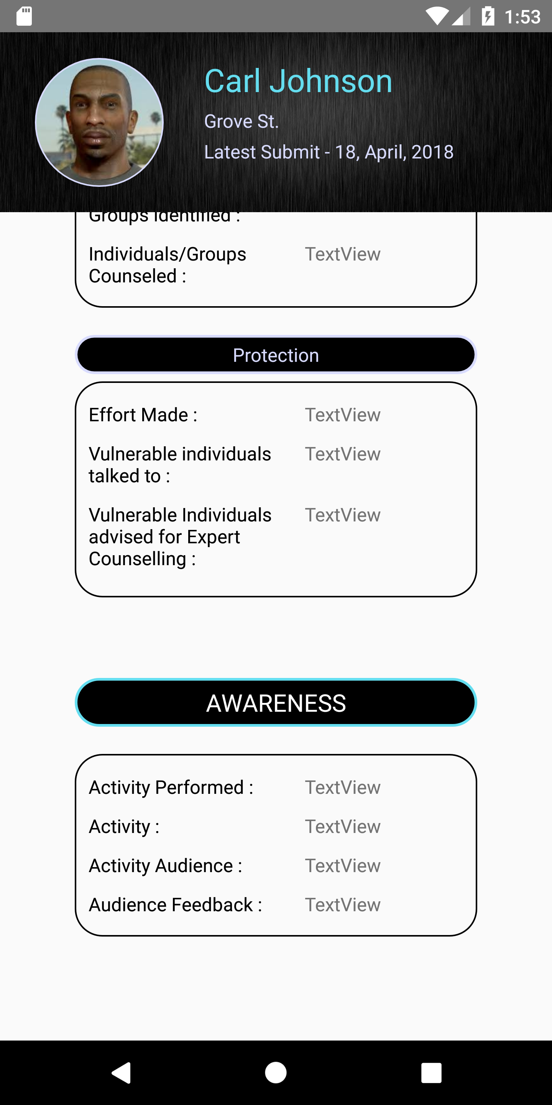
BRIEF PROGRESS
Shortened version of DAPO’s activities

Slide 43
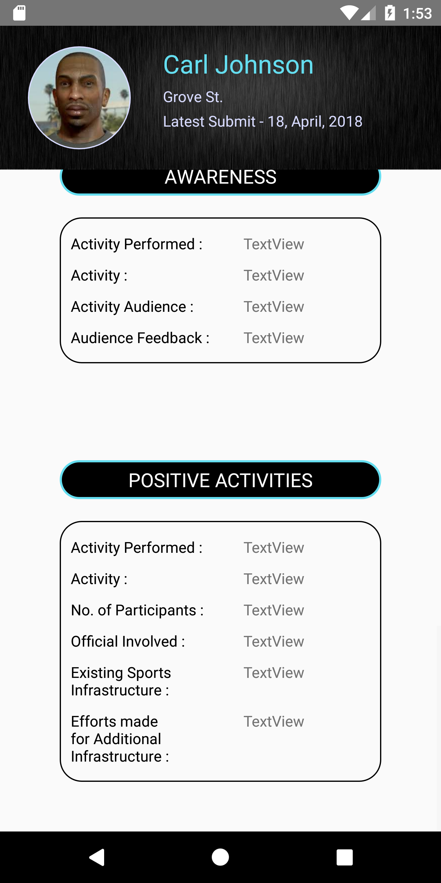
BRIEF PROGRESS
Shortened version of DAPO’s activities

Slide 44
Under work

Slide 45
Detailed description
Once the database is linked, each feedback form will be displayed with all the inputs given

Slide 46
DAPO achievers
DAPO of the month etc. on the basis of:
No. of drug abuse victims identified
No. of vulnerable groups protected
No. of drug abuse victims sent to de-addiction centres
No. of meetings held for awareness
No. of positive activities undertaken

Slide 47
Translation to Punjabi will be done soon

Slide 48
Thank you

